Slide 1
ABOUT US

Slide 2


















ideyaLabs Fact Sheet
ideyaLabs is a Silicon Valley based company focused on Product Engineering, SaaS, Enterprise Software development and technology consulting services for technology product companies and innovative SaaS enterprises.
ideyaLabs Focus Areas
24+ Clients
Over 1200 Releases
DIGITAL
IOT
DEVOPS
750+ Employees
650+ Engineering
PRACTICES
BIG DATA & ANALYTICS
CLOUD, INFRASTRUCTURE & SECURITY
DATA MANAGEMENT & GOVERNANCE
PRODUCT ENGINEERING
8 Locations
https://www.ideyalabs.com/locations
INDUSTRIES
HIGH TECH
BANKING & FINANCIAL
HEALTHCARE &
LIFESCIENCES
TELECOM
AUTOMOTIVE
2
Notes:
Option 1

Slide 3
ideyaLabs Org Chart
Prasad S: CEO, President
IDC Head, COO
BU HEADs
OTT - Media
QA - BU
BFSI -BU
5G - BU
IOT - BU
Cloud- BU
HR HEAD
OTT - NA
AI -QA
Core Banking
Wireless
Smart City
AWS, Azure
Head Operations
OTT - Europe
BFSI -QA
Blockchain
Smart City
Industry 4
Security
BU: Business Unit
OTT: Over The Top
BFSI: Banking and Fintech
IOT: Internet of Things
CoE: Center of Excellence
SMEs: Srini S + 15
Product Managers: Venkat + 9
PMO Office: Naveen + 24
CoE-Technology: Jagadish + 28
AI / ML: Rahul + 15
3
3
www.ideyaLabs.com

Slide 4















Representative Clients
High-Tech
Global
Leaders
High-Tech
Cutting Edge Start Ups
Financial Services
Telecom
Healthcare &
Life Sciences
Automotive
4

Slide 5
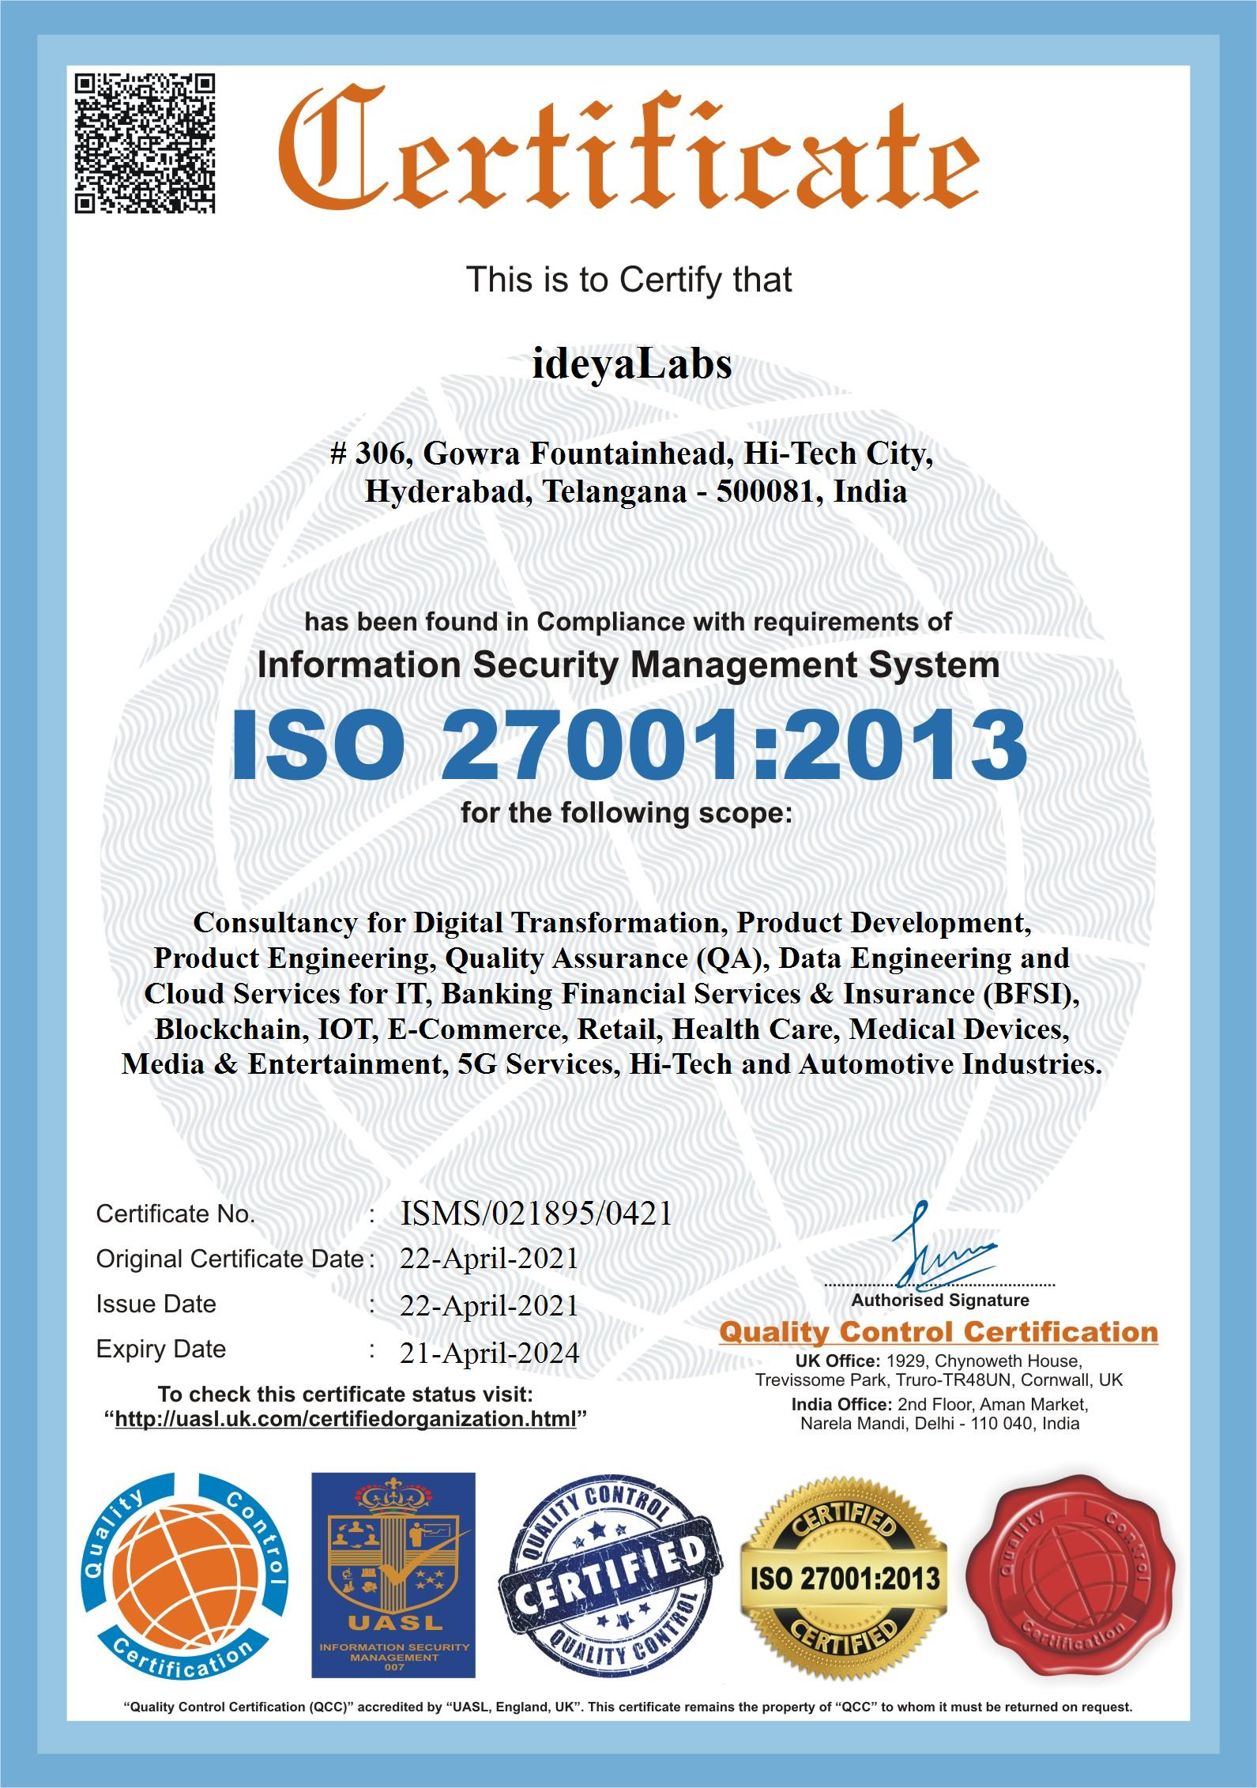
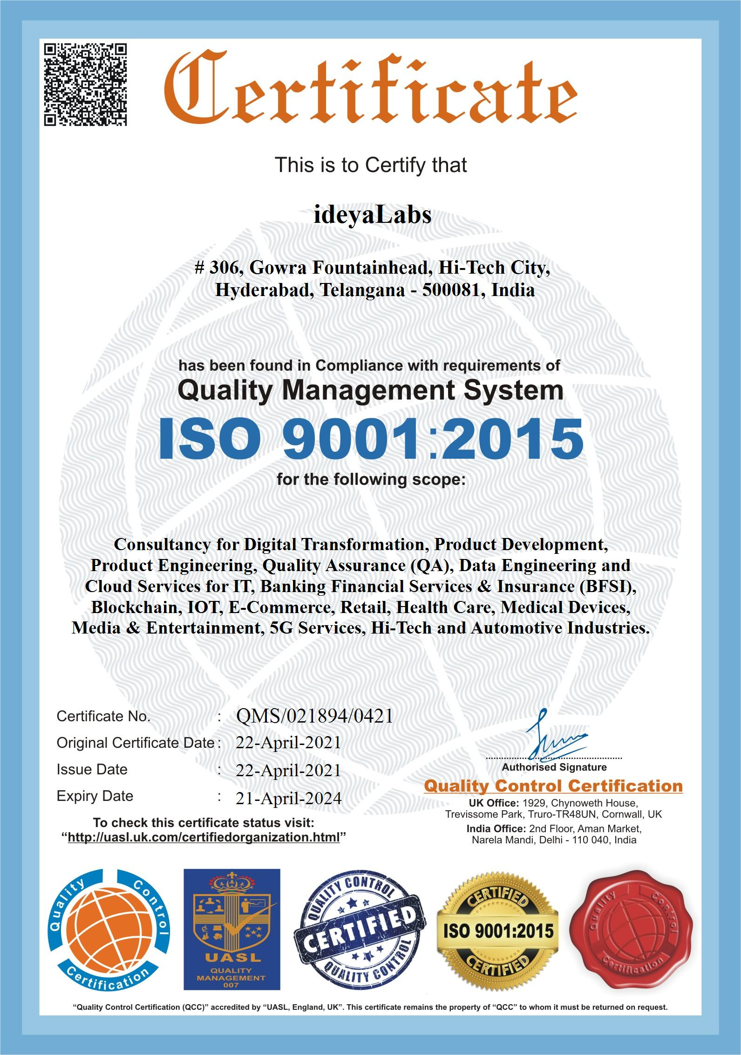
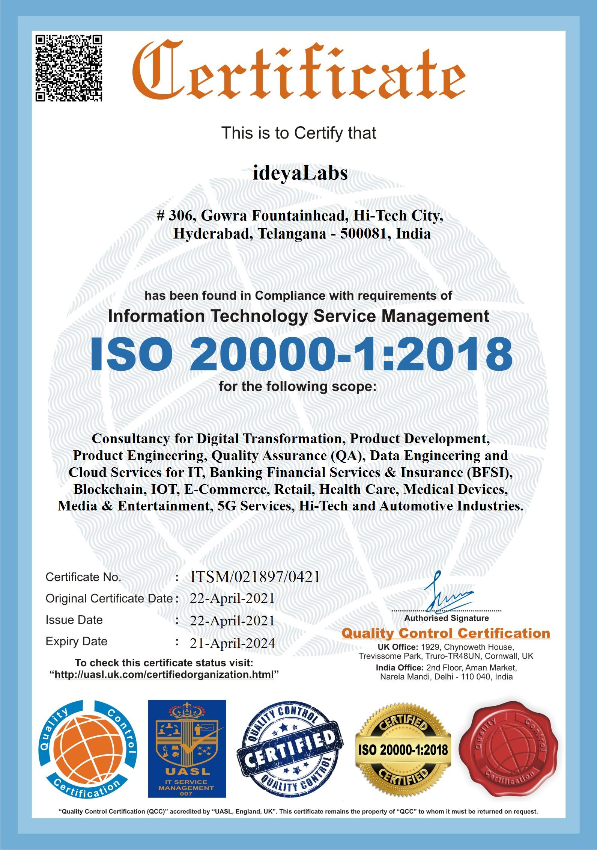
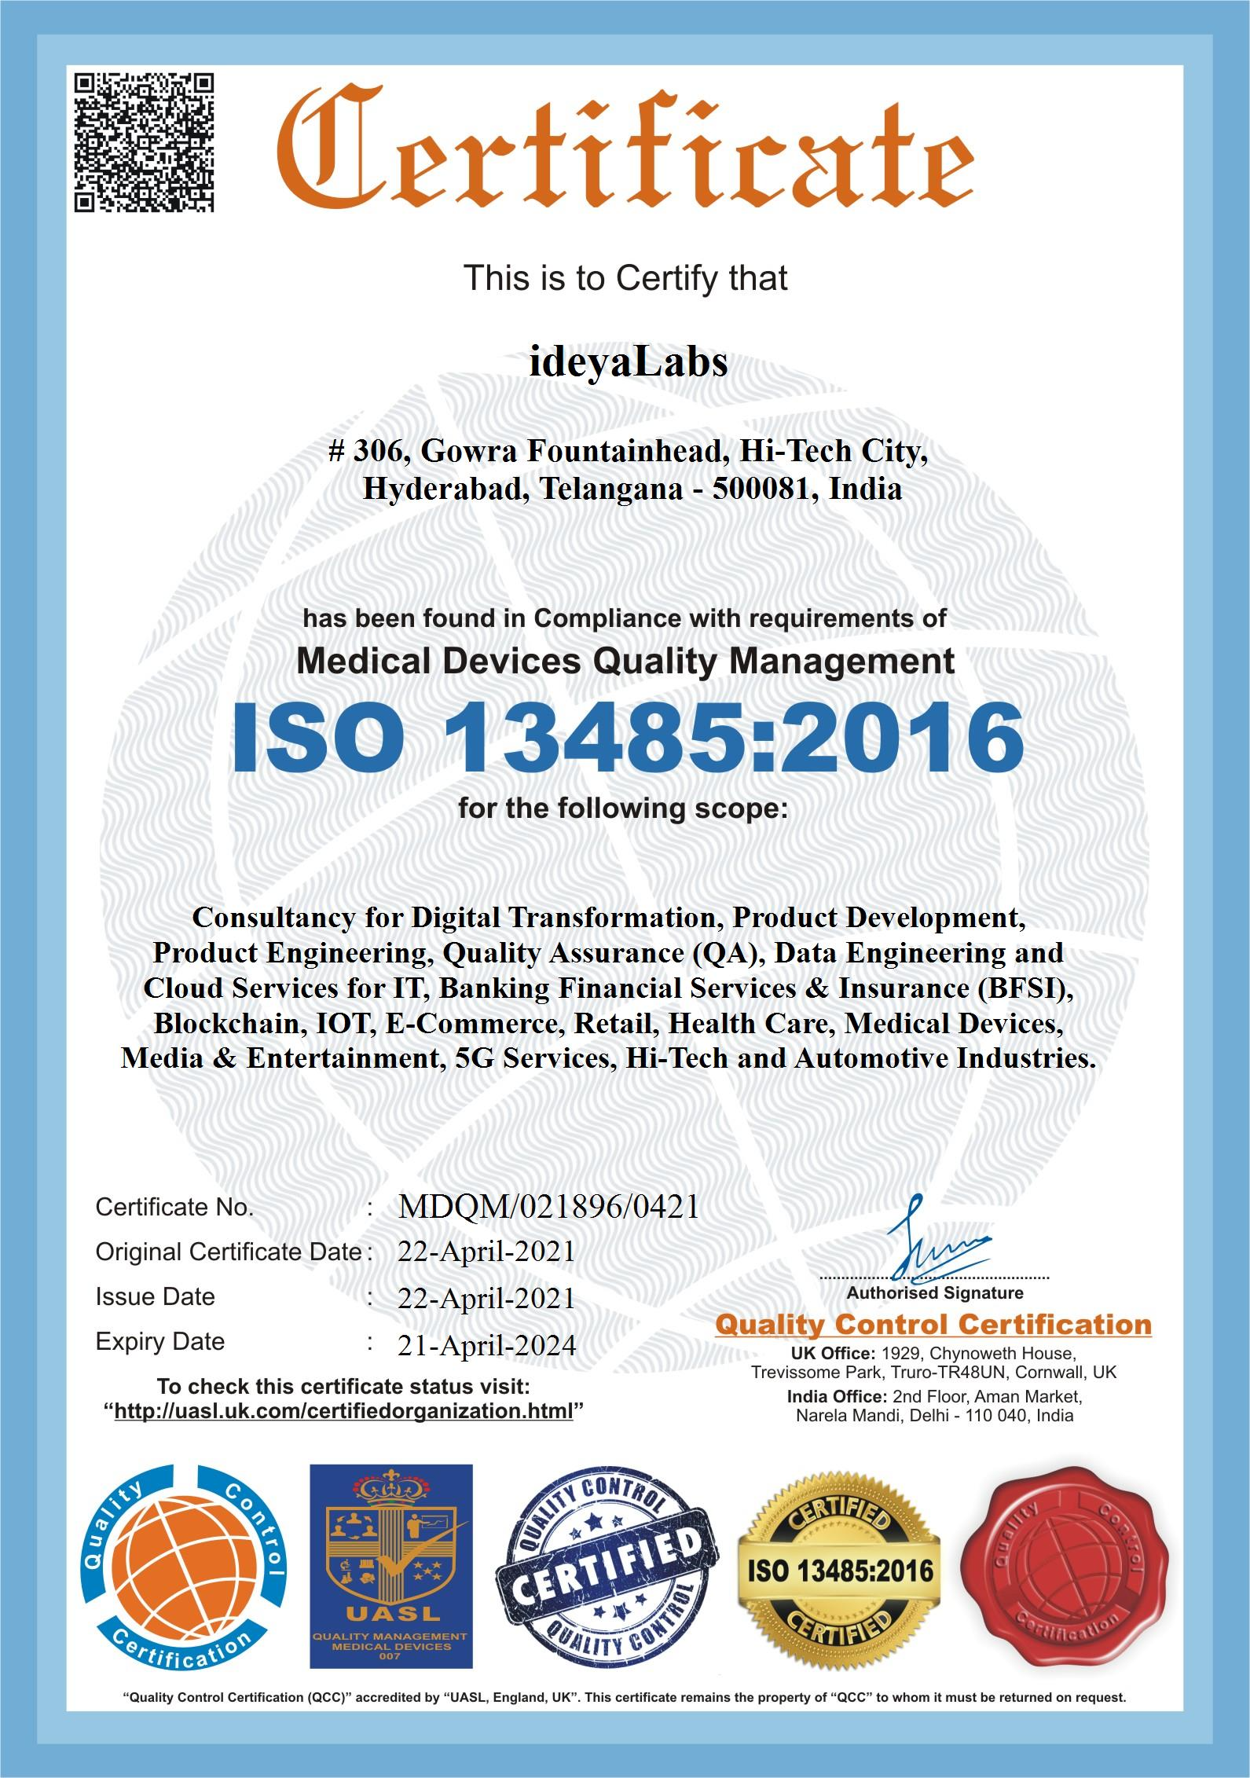

ideyaLabs Certifications
ISO 27001-1:2013
ISO 9001:2015
ISO 20001-1:2018
ISO 13485:2016
May 2022
Information Security Management System
Quality Management System: SaaS
IT Service Management
Medical Devices QMS
5

Slide 6
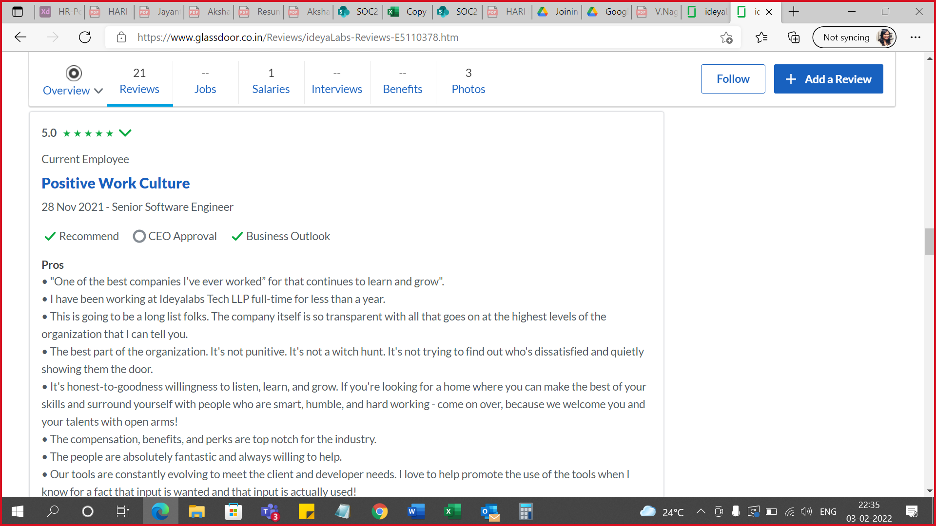
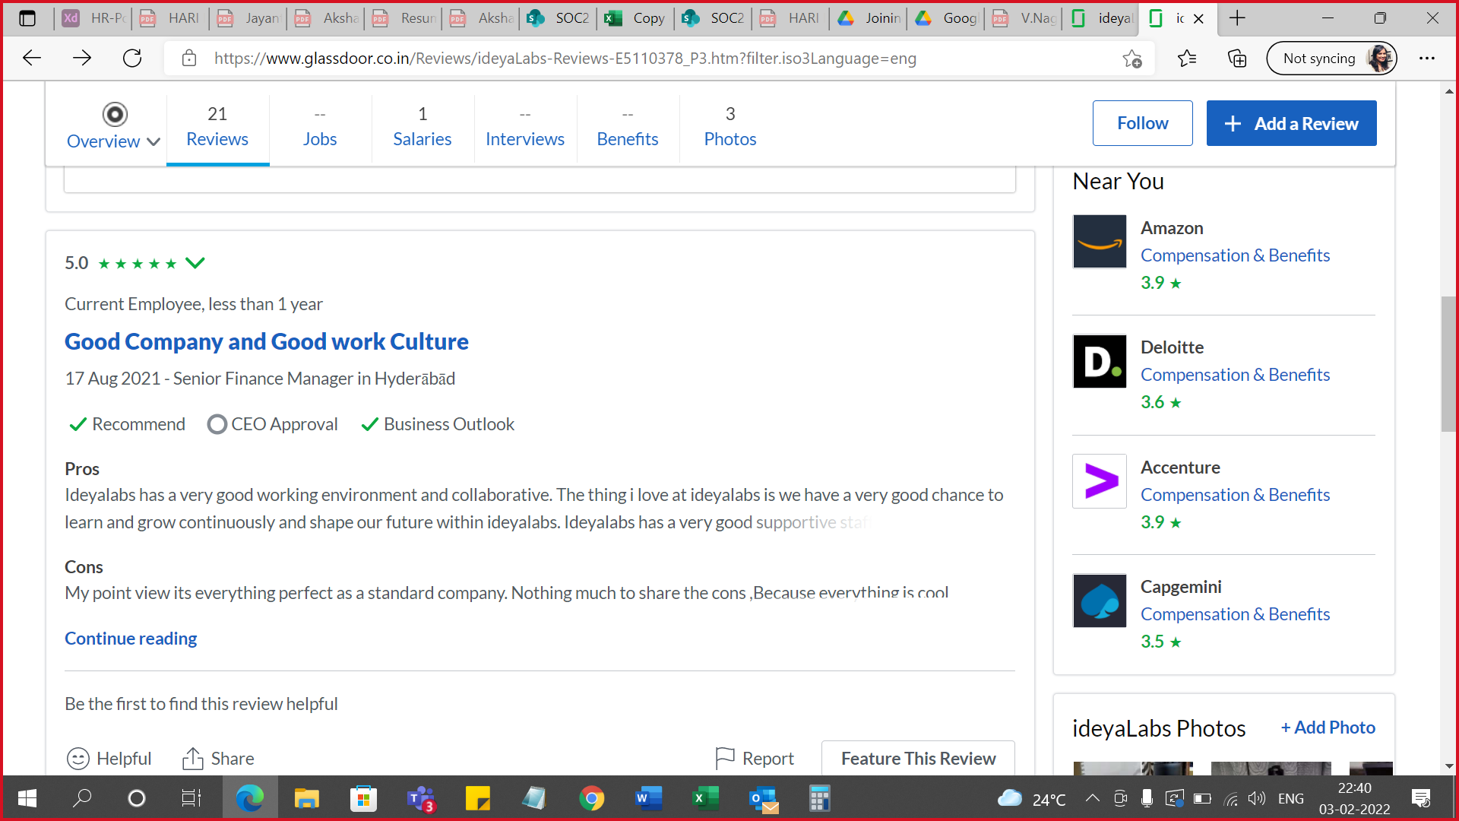
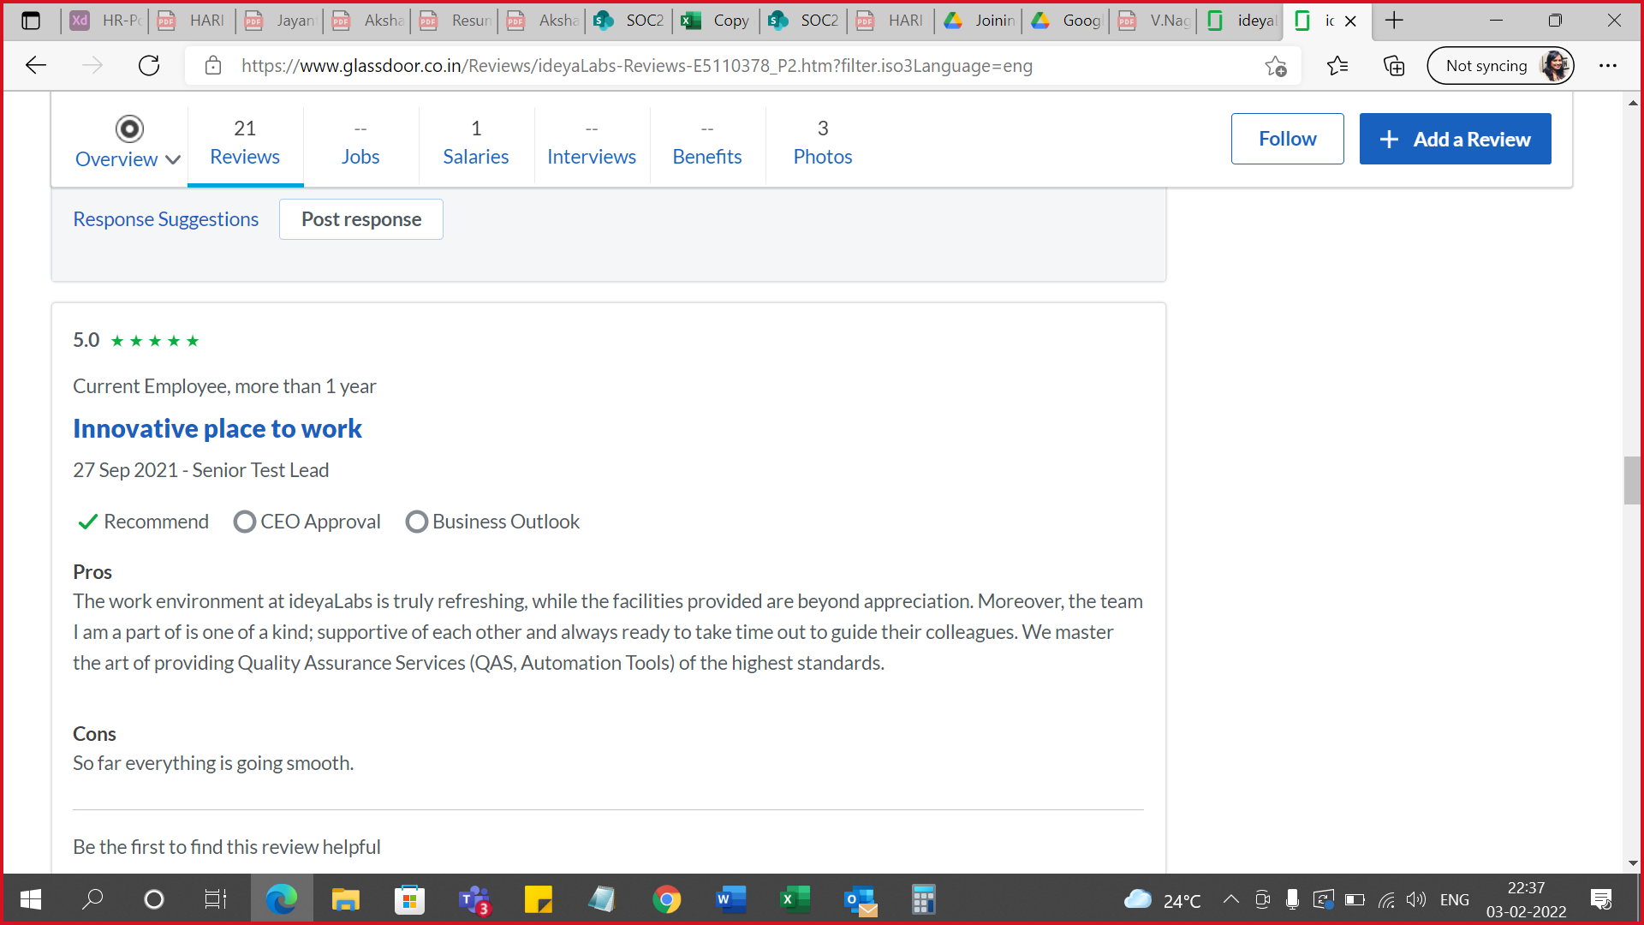
Glassdoor Reviews on ideyaLabs
Glassdoor Reviews Rating: 4.9 / 5.

Slide 7
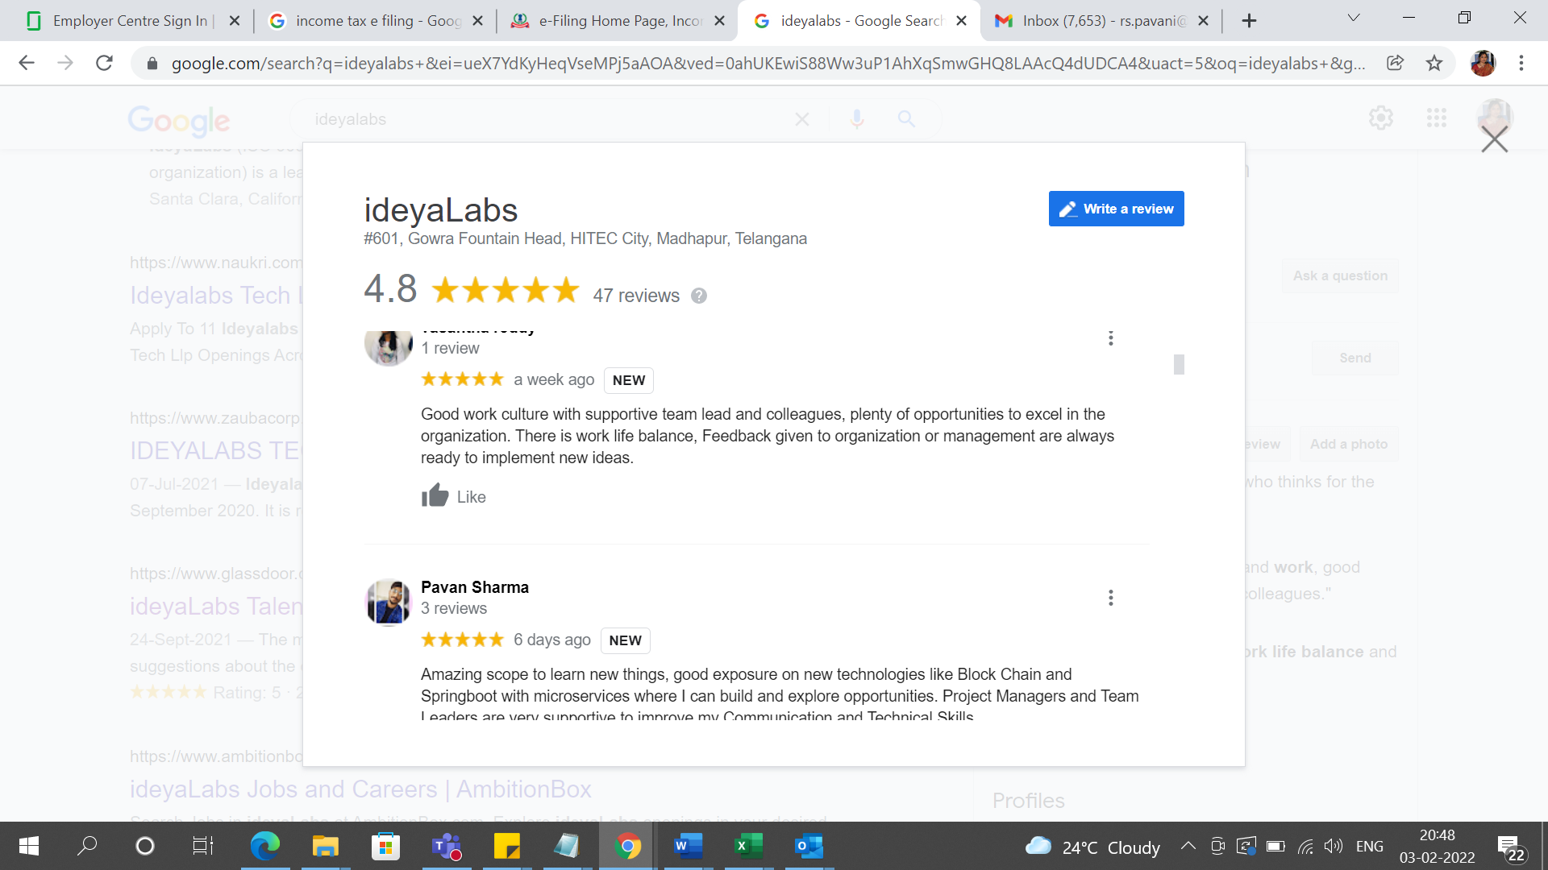
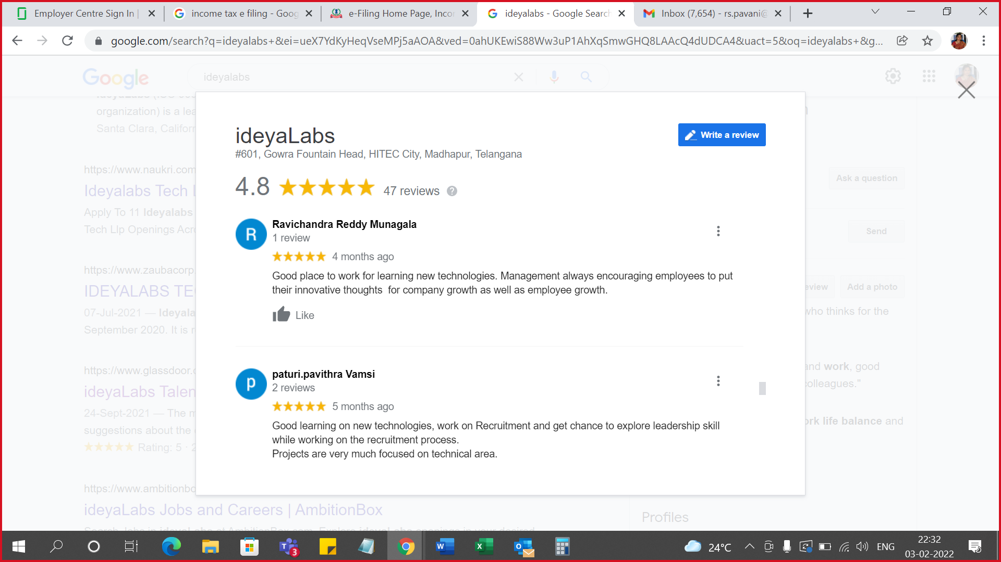
Google Reviews on ideyaLabs
Google Reviews Rating: 4.8 / 5.

Slide 8
Capabilities

Slide 9



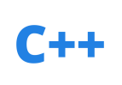














QA Practice
ideyaLabs brings over two decades of experience helping software teams ensure their products, systems, applications, and platforms behave as per the specifications and remain tightly integrated, secure, and compliant. In this, we have developed extensive testing capabilities for various verticals, across platforms, and applications.
KEY TECHNOLOGIES
HTML
JAVA
MANUAL TESTING
AUTOMATED TESTING
CLOUD TESTING
C++
MOBILE TESTING
PHP
PERFORMANCE ENGINEERING
9

Slide 10
















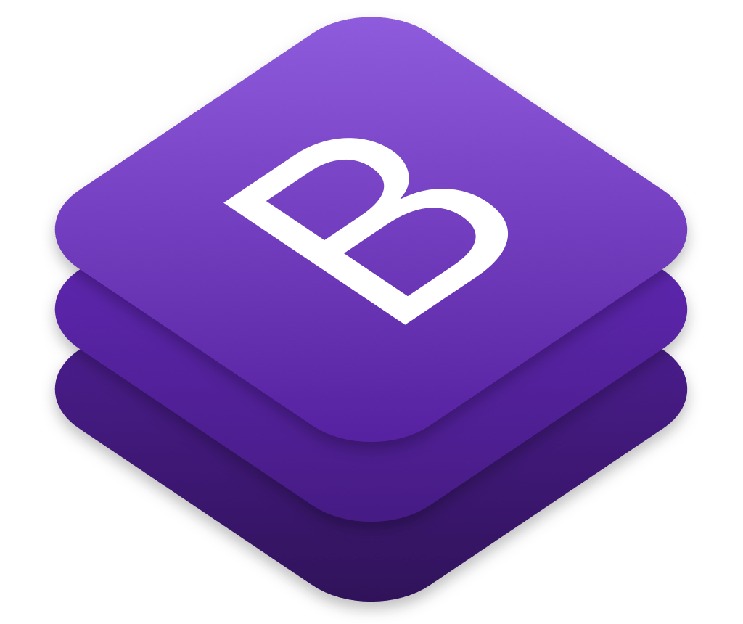
Frontend - UI Development Expertise
Globally 100 + Engineers including UI Engineers, UX Designers and UI Architects
KEY ENGAGEMENTS
Dedicated Practice with a Team of 100+ experts across multiple platforms and tools.
Expertise in the front–end technologies like HTML5, CSS3, jQuery with JS frameworks like Angular, React, D3, Backbone.
Creating responsive designs & cross-platform layouts using latest CSS3 frameworks.
Building fast, responsive single-page and rich JavaScript applications for both web & mobile platforms.
KEY TOOLS
10

Slide 11

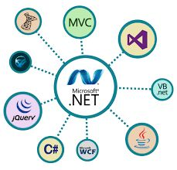






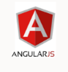









Backend Practice
Globally 100+ Java, .NET, NodeJS technology professionals including Product Specialists, Solution Architects, Technical Architects, Certified professionals
KEY TECHNOLOGIES
PRACTICE HIGHLIGHTS
Developed creative and innovative applications using Java, .NET, NodeJS technologies for different Domains
Delivered 200+ projects using technologies
Developed In-house, Natural Language based automation product named NLPro using Java
Proven expertise in Application development, Application re-engineering and enhancement, migration, porting, maintenance

Slide 12














Mobility Practice
ideyaLabs provides a holistic approach to first understanding the requirement, evaluating various technologies and then implementing a mobility solution that provides a significant ROI to our customers.
KEY TECHNOLOGIES
APPLICATIONS MANAGEMENT
TESTING
POST DEPLOYMENT
DEVICE MANAGEMENT
SECURITY
12

Slide 13








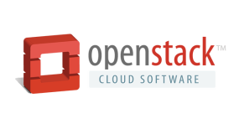








Cloud Practice
ideyaLabs cloud offerings span the entire spectrum of services from application to infrastructure and security.
CLOUD SERVICES
APPLICATIONS
DATA & ANALYTICS
INFRASTRUCTURE
SECURITY
DEVOPS
PLAN
BUILD
OPERATE
OPTIMIZE
LAB TESTING AND VALIDATION
KEY TECHNOLOGIES
13

Slide 14
PHP

Slide 15





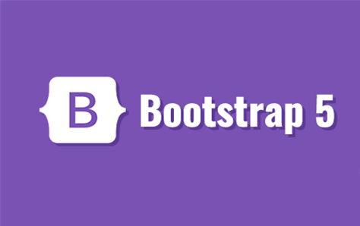
PHP Practice
Globally 100+ PHP technology professionals including Product Specialists, Solution Architects, Technical Architects, Certified professionals
KEY TECHNOLOGIES
PRACTICE HIGHLIGHTS
Developed creative and innovative applications using PHP technologies for different Domains
Delivered 200+ projects using technologies
Developed In-house, Natural Language based automation product
Proven expertise in Application development, Application re-engineering and enhancement, migration, porting, maintenance

Slide 16
Special Expertise on PHP Stack
Authentication Patterns
Customized tokens which are encrypted using SHA-256 algorithm
JWT tokens for REST API
BackEnd Programming-
PHP, REST API’S, Maria DB
Web Technology
HTML, CSS, AJAX, XML, Bootstrap
App Servers
Apache
Testing
JUnit, HttpUnit, EasyMock
Other Services
Bulk Emails (Using PHPMailer)
SMS
Auto Ticket generation by sending email to Support email

Slide 17




PHP Service Offerings
APPLICATION
REENGINEERING &
ENHANCEMENT
APPLICATION
DEVELOPMENT
MIGRATION &
PORTING
MAINTENANCE
App Development using Backend Frameworks
Web Services
Reports
Mobile Application Development
Legacy Technologies to PHP
Legacy Unix app to PHP apps
Legacy apps to Backend platforms
App Re-Engineering
Architectural Design
Functional Features Requirements
Quality Assurance
Design & Development Applications
Application Maintenance
Re-Development & Re-Engineering

Slide 18
Key Projects Executed on the Back End
Design and development of a comprehensive end-to-end core PHP and enterprise class software applications in the areas of supply chain, asset management, various business processes/functions in financial services, healthcare, network management, storage management, etc
Development and implementation of plug-ins and extra features in the existing Java software application development
Migration and porting of PHP applications to other architectural platforms and vice versa
White box, performance, and stress testing of PHP and integration testing of the application
Integrating Back End applications with other back-office applications
Performance tuning of PHP applications

Slide 19


Implementation for CRM
BUSINESS PROBLEM AND SCOPE
CRM
Contact Management : Capturing the primary and secondary contact details who can take a decision.
Opportunity Management: This component decides whether the opportunity will be converted to lead.
Sales Analytics : Helps to create better marketing campaign’s by analyzing the hard data of previous campaigns.
Chat Integration : Integrated the Chat feature with CRM through which you can chat with Employees , Partners and Customers.
OVERVIEW
Our client has web-based application for Ticketing and Lead Generation. It would track new opportunities with different products signed by sales team across the world.
Solution is a suite of applications which help clients to get the best possible ways for new leads.
Billing Module (Invoicing, Payments etc..)
Expenses Module
Complaints Module
ideyaLabs SOLUTION
Developed thin performance responsive UI with HTML, CSS and Bootstrap.
Built webservices with Rest API’s.
Used CodeIgniter framework for authentication and authorization.
CRM has a unique architecture of two separate UI modules: Sales and Complaints. They can be independently deployed and managed.
Individually Managed services easily deployable independently Individual services can be upgraded without affecting other with minimum downtime.
All the UI communications are state-less, thus eliminating the need and overhead of maintaining sessions
BUSINESS BENEFITS
Sales person would be able to view how their different accounts are doing and how much profit they are making on each product.
It would also track for an Individual product wise complaints and service history.
Complete End-2-End flow for Lead Generation.
Customized lead generation process as per customer requirement.
TECHNOLOGY STACK
Operating Systems - Linux (CentOS), Languages - PHP (CodeIgniter), REST API, Maria DB - (MySQL), Web Server - Apache.

Slide 20




REST API Implementation for CRM
http/ https : Common Port
UI
Apache Proxy Server
REST Api
Proxy Configuration file (Reverse Proxy)
Authentication using Username/Password
Complaints UI
Sales / Leads UI

Slide 21


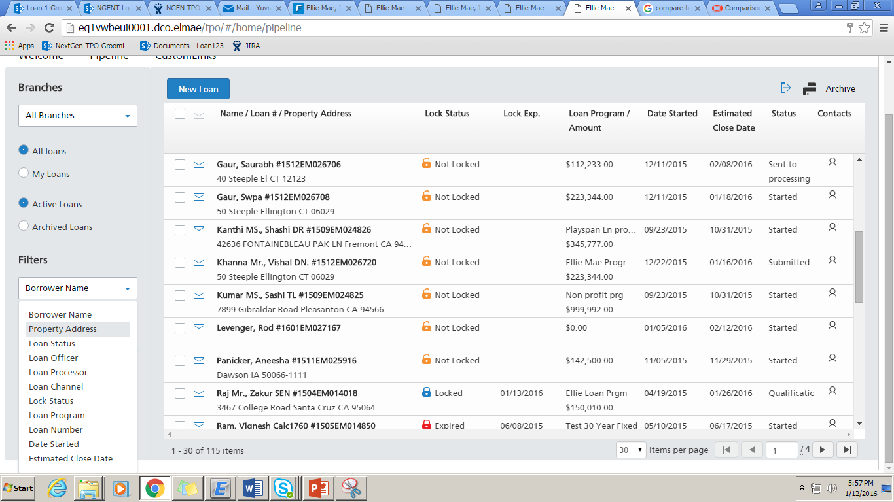
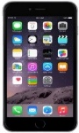
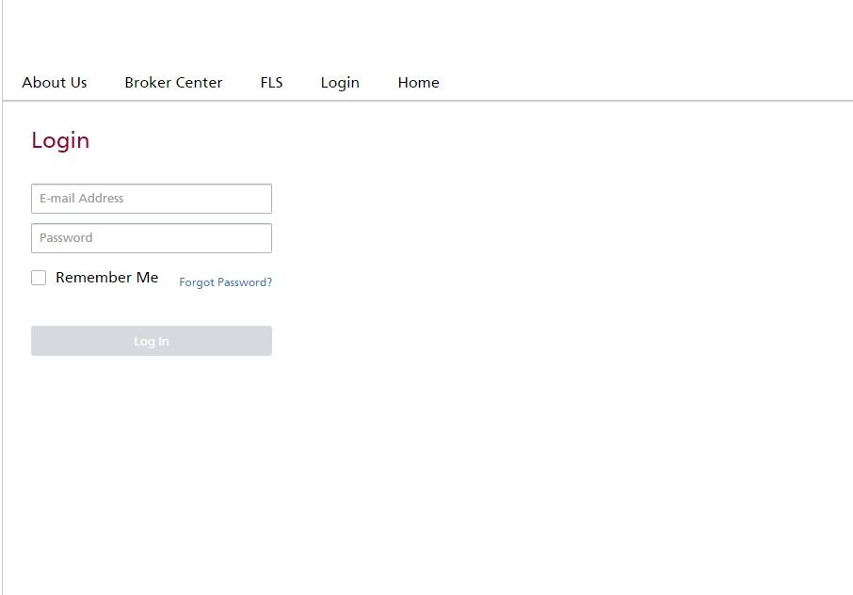
Modernization from Legacy Product to Platform
Architecture
Secured Login
Security
Web Portal
Mobile Application
Enterprise Services
Client Browser
Web Server (MVC)
Lead Management
Billing Management
Order Management
Digital Documents
Complaint Management
HTML5/CSS3
View
Service Layer
JavaScript / JQuery / AJAX
Model
Company Setup/Settings
Local Storage
Controller
Data Access Layer
Database

Slide 22

Bid Generation Process
BUSINESS PROBLEM AND SCOPE
The current project scope deals with the Admin Portal. Only community team can bid on behalf of the Customers, which is a client facing problem.
Integration of Payment gateway.
Integration of FedEx.
CLIENT OVERVIEW
Our client’s provides Bidding Solution to several charities across states in USA.
The solution is designed to Customer can bid for any items they like. Highest bid amount can receive the item amongst all the bids for that item.
Payment integration with PayPal and Authorize.net
Items can be shipped based on the selected shipping carriers available for their locations.
ideyaLabs SOLUTION
ideyaLabs team is currently working on Digital form Module thereby enabling the Customer to view all items and they can bid for the items they like.
ideyaLabs is contributing towards front end UI development using HTML,CSS and Bootstrap as well as developing Customer Portal, integration of payment gateway and separating business rules from business logic in application code
Integrated PayPal and Authorize.net
For shipping of items, integrated FedEx shipping API.
Multiple Report Generation.
BUSINESS BENEFITS
TECHNOLOGY STACK
Increased collaboration between customer and Community Auctions
Maximize revenue and eliminate inefficiencies throughout the revenue cycles
Core PHP, Maria DB (MySQL), REST API, Apache Server, Linux (Centos 8)
Notes:
Neural analytics

Slide 23
Micro services Implementation
Architecture
Frontend (Microservices)
HTML 5
CSS3
Javascript
Bootstraps UI
Dockerized instances
Mysql
Backend (Microservices)
http/ https
(JSON WEB TOKEN)
Dockerized instances
Linux environment
RDBMS

Slide 24
Bidding Management
Architecture
Secured Login
Security
Web Portal
Services
Client Browser
Web Server
Master Data
Bid Management
Order Management
Reports
Auctions Management
HTML5/CSS3/ BOOTSTRAP5
Application Layer
JavaScript / Jquery/Ajax
Data Access Layer
Local Storage
Database

Slide 25
Implementation for Gated Community Management
BUSINESS PROBLEM AND SCOPE
GCM
Many gated communities still using the old model for Monthly Maintenances, General meeting and complaints. Still they are using books or papers to track all these activities.
Online payments.
Complaints tracking.
Visitor Management and Vehicle Management.
OVERVIEW
This gated community social networking platform which helps to connect the living community and vendors.
Residents can pay their Monthly Maintenances through integrated Payment Gateway. They can get Instant SMS on the payment receipt and email with the acknowledgement to the registered email ID.
Flexibility to manage multiple properties, Tenants and Apartment data including Resident Details, Parking allotments etc.
ideyaLabs SOLUTION
Developed thin performance responsive UI with HTML, CSS and Bootstrap.
Built webservices with Rest API.
Used CodeIgniter framework for authentication and authorization.
GCM has a unique architecture : All the modules are independently deployed and managed.
Individually Managed services easily deployable independently Individual services can be upgraded without affecting other with minimum downtime.
Integration of payment gateway for Online payments.
BUSINESS BENEFITS
An application that simplifies life for everyone in a gated community, from residents and management committee members to security guards and facility managers.
Manage accounts and payments, resolve complaints and keep the community up-to-date with all that’s going on in the society. Easy for the management committee and residents.
TECHNOLOGY STACK
Operating Systems – Linux (CentOS), Languages – PHP (CodeIgniter), REST API, Maria DB (Mysql), Web server – Apache.

Slide 26
Gated Community Management Features
1. Payments : Residents can pay their Monthly Maintenances through integrated payment gateway. They can get instant SMS on the payment receipt and email with the acknowledgement to the registered email-id.
2. Document Management : One place where in all documents can be placed and shared to all residents.
3. Property Management : Flexibility to manage multiple properties, Tenants and Apartment data including Resident details, Parking allotments etc.
4. Complaint Management : Residents can raise complaints at their ease and can monitor their complaint status either on provided Web interface or on Mobile app. Residents can re-open their tickets if the complaint is not addressed as per their satisfaction.
5. Facility booking : Provides real time club house/tennis courts slot availability details and facilitates booking with online payment gateway integration. This feature brings ease of booking at your convenient time.
6. Activities Notification : You feel connected with this module as it gives notifications on Mobile App / Web Interface / SMS message based on the activities, so that every resident feel connected with the ongoing activities in the community.
7. Resident Directory : You can have all contact details at one place and is readily available to get access at any time. You can find professionals i.e. Doctors in case of emergency.
8. Vendor Directory : Approved vendors details will be seen and you can directly call them to avail their services.
9. Billing & Accounting : Reduces 80% of work load for collections and reconciliations and helps to keep cashflow data on finger tips and provides transparency.
10. Expense Tracker : This module provides facility to track expenses against different headers. Property manager can create different expenses headers dynamically. It provides single view of complete expenses and sub components of expenses.
11. Visitor Management : Resident or Tenant can post his expected visitor / vendor with identification details, so that the security guards at gates can allow the visitors without any waiting at the gate.
12. Intercom : For taking approvals from residents, guards can make GSM calls from Visitor Management system itself or they can make What’s app call whichever is feasible.

Slide 27
REST API Implementation for GCM
http/ https : Common Port
UI
(JSON WEB TOKEN)
Apache Proxy Server
Secured JWT’s
REST API
Proxy Configuration file (Reverse Proxy)
Authentication using Username/Password
Resident UI
Admin UI
Gatekeeper UI

Slide 28
GC Management
Architecture
Secured Login
Security
Web Portal
Mobile Application
Services
Client Browser
Web Server (MVC)
Master Data
Property Management
Visitor Management
Expense Management
Billing Management
HTML5/CSS3/ BOOTSTRAP5
View
Service Layer
JavaScript / Jquery/Ajax
Model
Data Access Layer
Local Storage
Controller
Database

Slide 29
API Microservices Implementation For Mobile App
BUSINESS PROBLEM AND SCOPE
High-Tech Global Leader
An Independent Backend System: A simple independent microservice which can be maintained and deployed separately without depending on the mobile application.
Separate Admin portal : A complete separate portal where admin can get the complete transaction list and handle the transactions for finance management .
Complete migration : They require a migration of the complete microservices which can handle the huge traffic as the app moved to national level from state wide.
OVERVIEW
Our client has a mobile application where users can do payments in the petrol stations using the app.
Solution is to provide a set of API’s which will be independent of the app and works on a separate server which further handles the payment and saving the credit/debit cards.
ideyaLabs SOLUTION
Developed API services with the best framework which can handle thousands of request every second.
Built Microservices with Ubiquity(PHP framework).
Used Redis cache which further reduces the number of calls to the database.
Designed and developed a complete front-end system (SPA) using Vue.js which helps to get the transaction list along with user information.
Individually Managed services easily deployable independently Individual services can be upgraded without affecting other with minimum downtime. maintaining sessions
BUSINESS BENEFITS
Finance team would be able to monitor all the transactions and can export the records.
Finance team can issue refund, cancel payments accordingly. They can set the banners in the mobile app using the portal in real-time.
TECHNOLOGY STACK
Operating Systems – Centos, Languages – PHP, Ubiquity, Vue Web server – Apache Tomcat, Redis, Aws.

Slide 30
Features:
1. Complete independent service which has no dependency for deployment of front-end system.
2. Add or save credit card or debit cards(Tokenization), which uses AWS key management service for saving the card details in cloud and follows PCIDSS regulations.
3. Charging of cards using tokenization
4. Create a recurring payment service and can be stopped by using the simple API’s which are integrated with the mobile app front end.
5. SPA for easy access of all the transactions and can perform operations like refund and cancel payment.
6. Users can authorize, cancel or request refund the payments.
7. Use ubiquity framework which enables to handle huge traffic
8. JWT token is used for user authentication.
9. Schedulers and crons to monitor the system performance.

Slide 31
Micro services Implementation
Architecture
Frontend (Microservices)
HTML 5
CSS3
Vue js with Vuex
Bootstraps UI
Dockerized instances
Mysql
Backend (Microservices)
http/ https
(JSON WEB TOKEN)
Redis
AWS (KMS)
Ubiquity
Dockerized instances
Linux / Unix environment
RDBMS

Slide 32
Migration to Laravel 8
BUSINESS PROBLEM AND SCOPE
Migration from Laravel 5.1 to 8.x
As the Laravel version is upgrading gradually and including many new features, system need to upgrade as the support for the old version is decreasing and there are many new features included in latest version along with the support. As to keep up with new version and make the system to function flawlessly and include new features system need to upgrade both PHP and Laravel version and migrate to latest version of plugins which help to run the system smoothly
CLIENT OVERVIEW
Our client provides a system which Promote your brand to kids and apps which are safe and run campaigns. This system runs on Laravel 5.1, Php 7.1.3 and Redis cache which have become very obsolete and need migration.
The solution is to upgrade Laravel to 8.X in a sequence way which involves implementation of Multi Auth, remove custom providers and use the eloquent guards.
ideyaLabs SOLUTION
ideyaLabs team is currently working on migration of Laravel from 5.1 to 8.X which enables the client to use the Eloquent based Multi Authentication with custom guards.
Upgrading or rewriting all the deprecated functions in PHP 8.1 version and upgrading all the plugins which have been deprecated In the latest versions.
Writing Smoke tests and unit tests for all the functionalities to make migration seamlessly.
BUSINESS BENEFITS
TECHNOLOGY STACK
Migrating to latest version of PHP and Laravel has brought the advantage to use the default Eloquent Based Multi Auth, removed the old custom providers
Achieve better performance by using the latest version of plugins, code refactor and upgrade all the deprecated functions both in Laravel and PHP.
Laravel, MySQL,Postgres, RedShift , Aws, Redis, Elastic Search, Restful webservices
Notes:
Neural analytics

Slide 33
Features:
1. Multi level Authorization system with Google captcha and 2 factor Authentication
2. Multiple dashboards and operations depending on the roles
3. Custom providers for registration and logins
4. Creation of schedulers to save the data from master to slave database.
5. Creation on multiple campaigns and clusters to group all the campaigns
6. Use of high charts for reporting
7. Scheduler to monitor the complete system performance on daily basis
8. Automated data backup everyday using the AWS.

Slide 34
Migrated Architecture of the system
Architecture
Secured Login
Security
Web Portal
Services
Client Browser
Web Server (MVC)
Registration
Multi level user login
Creation of campaigns
Online Payment/offline Payment
Reports using high charts
HTML5/CSS3
View
Redis
JavaScript / JQuery / MVC
Model
AWS
Local Storage
Controller
Database

Slide 35
Service Tax Calculation System
BUSINESS PROBLEM AND SCOPE
Multilevel roles, where every application must pass through each role.
Third party integration for Authorization.
Need to support both Online payments and Offline payments.
Need to generate dynamic tax durations according to the dates.
CLIENT OVERVIEW
Our client provides a service tax system which allows to register under the system ,generate the digital service tax and pay online
The solution is to build a system using Laravel framework which has multi level users and authentication and integrated with third-party API’s for authorization.
ideyaLabs SOLUTION
ideyaLabs team developed a system which includes multiple micro services which handles Authorization, generation of tax durations, calculation tax amount and penalty amounts.
Integrated both offline payment flow and online payment flow in the system which reduces the manual checking.
GNUPG encryption id used to decrypt the files and run individually
Writing Smoke tests and unit tests for all the functionalities to check the complete functionalities.
BUSINESS BENEFITS
Complete online system which enables users to directly register and get their tax to be calculated completely online and pay the tax both in offline and online methods
All the reports are transferred using the GNUPG encryption securely
TECHNOLOGY STACK
Laravel (8), MySQL, Redis, Restful Webservices, GNUPG, jQuery
Notes:
Neural analytics

Slide 36
Features:
1. Multi level Authorization system with 2 factor Authentication
2. Multiple dashboards and operations depending on the roles
3. Creation of Periods for tax paying dynamically using the schedulers
4. GNUPG encryption and decryption in order to save and read the files from the banking system
5. Online and offline payments for user
6. Multiple modules and user flow for user like Query, Debt management and remission
7. Third party API integration which is required to authorize the internal staff from a different system
8. Dynamic Tax and Penalty calculations

Slide 37
Micro services Implementation
Architecture
Frontend (Microservices)
HTML 5
CSS3
Bootstraps UI
Mysql
Dockerized instances
Backend (Microservices)
http/ https
Redis
AWS
Laravel
jQuery
Dockerized instances
Linux / Unix environment
RDBMS

Slide 38
Microservices

Slide 39
Backend Practice
Globally 100+ Java, .NET, NodeJS technology professionals including Product Specialists, Solution Architects, Technical Architects, Certified professionals
KEY TECHNOLOGIES
PRACTICE HIGHLIGHTS
Developed creative and innovative applications using Java, .NET, NodeJS technologies for different Domains
Delivered 200+ projects using technologies
Developed In-house, Natural Language based automation product named NLPro using Java
Proven expertise in Application development, Application re-engineering and enhancement, migration, porting, maintenance

Slide 40
Special Expertise on Backend Stack
EJB Design Patterns
Session Facade, EJB Command, Data Transfer Object, Business Delegate, EJB HomeFactory
BackEnd Programming-
Servlets, Swing, Hibernate, ODBC, Spring, Acegi, jMatter
Web Technology
XMLC, JSP, AJAX, DHTML, CSS, XML, XSLT, Jasper, JFree, iText
XML Processing
Xalan, Xerces, JDOM
App Servers
Apache, Tomcat, Jboss, Portals, JA-SIG, Grinder, Selenium
Testing
JUnit, HttpUnit, EasyMock
J2EE Technologies
EJB (Entity, Stateful, Stateless), EJB Patterns, JNDI, JDBC, JAAS, XDoclet, JavaMail, JNI, RMI, JMS

Slide 41
Backend Service Offerings
APPLICATION
REENGINEERING &
ENHANCEMENT
APPLICATION
DEVELOPMENT
MIGRATION &
PORTING
MAINTENANCE
App Development using Backend Frameworks
Web Services
Reports
Mobile Application Development
Legacy Technologies to Java, .NET, NodeJS
Legacy Unix app to Java, .NET, NodeJS apps
Legacy apps to Backend platforms
App Re-Engineering
Architectural Design
Functional Features Requirements
Quality Assurance
Design & Development Applications
Application Maintenance
Re development & Re engineering

Slide 42
Key Projects Executed on the Back End
Design and development of a comprehensive end-to-end core Java and .NET enterprise class software applications in the areas of supply chain, asset management, various business processes/functions in financial services, healthcare, network management, storage management, etc
Development and implementation of plug-ins and extra features in the existing Java software application development
Migration and porting of J2EE, .NET software applications to other architectural platforms and vice versa
White box, performance, and stress testing of J2EE, .NET components and integration testing of the application
Integrating Back End applications with other back-office applications
Performance tuning of Java, .NET applications

Slide 43
Microservices Implementation for Desk Support System
BUSINESS PROBLEM AND SCOPE
High-Tech Global Leader
A Classification Engine: Help to mine customers or Carriers messages and classify into categories
A Pricing Advisor: Helps prepare custom quotes based on the flow casts and constraints imposed to objectives defined for the particular
A Margin now-casting Engine: This component is more a reporting engine that reports up to minute margin position
A Route Matching Engine: The current search-based methodology should migrate to a pure matching engine while at the same time maintaining the manual search and assign capabilities
OVERVIEW
Our client has web-based applications for Sales and Operations. It would track revenue being realized for different contracts signed by sales team across the world
Solution is a suite of applications which help clients to get the best possible routes with desired margin and profits for SMS Aggregation with help of data mining
ideyaLabs SOLUTION
Developed thin performant responsive UI with React JS
Built Microservices with Spring Boot
Used Spring security framework for authentication and authorization
ADS has a unique architecture of two separate UI microservices: Sales and Operations. They can be independently deployed and managed
Individually Managed services easily deployable independently Individual services can be upgraded without affecting other with minimum downtime.
All the UI communications are state-less, thus eliminating the need and overhead of maintaining sessions
BUSINESS BENEFITS
Sales person would be able to view how their different accounts are doing and how much profit they are making on each contract
It would also track supplier prices changes in real time and automate price change notification to customer
TECHNOLOGY STACK
Operating Systems – Windows, Languages – Java, Spring Boot, React, Web server – Apache Tomcat, Node JS.

Slide 44
Microservices Implementation for Arbitrage Desk Support System
Architecture
Frontend (Microservices)
HTML 5
CSS3
React JS with Redux
Bootstraps UI
Dockerized instances
NODE Web Server
Mongo DB
Kafka
Backend (Microservices)
http/ https
Keycloak
(Identity and Access Management)
JDK 8
Kafka
Spring Boot
Spring Data
Spring Security
Embedded App Server
Dockerized instances
Linux / Unix environment
JDBC
Database - Datamart
SAP ASE DBMS
Database - CTOOL

Slide 45
Microservices Implementation for Desk Support System
UI Microservices
http/ https : Common Port
UI
Apache Proxy Server
Keycloak Node Library
(Dockerized)
Proxy Configuration file (Reverse Proxy)
Authentication using Username/Password
Operations UI
MS
(Dockerized)
Sales UI
MS
(Dockerized)
Authentication Token
Kafka
(Dockerized)
Spring Cloud - Gateway
Keycloak Spring Boot
Eureka : Service Discovery
Zuul : Routing
Hysterix: Circuit Breaker
Authorize

Slide 46
Integrated Patient Access Solution (iPAS)
BUSINESS PROBLEM AND SCOPE
Patient Access technology solutions
The current project scope deals with the Patient Portal. Patients can use VIM (Virtual Intake Management), which is a client facing application to validate themselves, confirm appointment, complete form
CLIENT OVERVIEW
Our client’s provides Patient Access Solution iPAS (Integrated Patient Access Solution) several hospitals across states in USA to help hospitals and physicians improve patient experience,
The solution is designed to financially clear patients at the first point of contact by increasing the quality of registrations, maximizing point of service payments, and using cloud-based technology
ideyaLabs SOLUTION
ideyaLabs team is currently working on Digital form Module thereby enabling the client to view all digital documents and forms for a patient visit with an ability to edit, print, download and request for signature.
ideyaLabs is contributing towards front end UI development using Angular as well as developing Digital Document Services, integration of BRMS – inRule separating business rules from business logic in application code
ideyaLabs team is also building payment facilitator module which allows patients to book appointment and facilitates secured payment processing . It also takes care of discount processing which is provided by various healthcare providers In
BUSINESS BENEFITS
TECHNOLOGY STACK
Increased collaboration between patient, provider and payer
Maximize revenue and eliminate inefficiencies throughout the revenue cycles
Angular 9, .NET Core, SQL, Cosmos, Reddis, Elastic Search, MicroService, Event Bus ( Microsoft Azure Bus), inRule (BRMS)
Notes:
Neural analytics

Slide 47
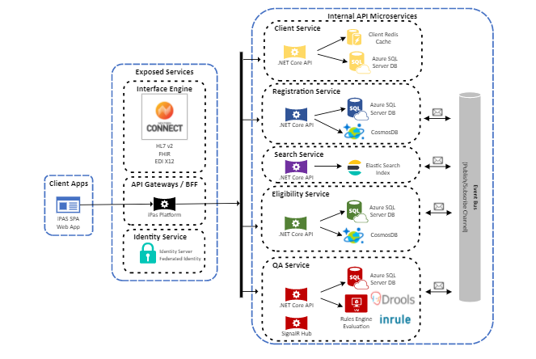
Integrated Patient Access (iPAS) Solution
Architecture

Slide 48
ReactJS

Slide 49
Front End - Practice

Slide 50
UI Development Expertise
Globally 100 + Engineers including UI Engineers, UX Designers and UI Architects
KEY ENGAGEMENTS
Dedicated Practice with a Team of 100+ experts across multiple platforms and tools.
Expertise in the front–end technologies like HTML5, CSS3, jQuery with JS frameworks like Angular, React, D3, Backbone.
Creating responsive designs & cross-platform layouts using latest CSS3 frameworks.
Building fast, responsive single-page and rich JavaScript applications for both web & mobile platforms.
KEY TOOLS

Slide 51






Process
Creating responsive designs & cross-platform layouts using latest CSS3 frameworks
Building fast, responsive single-page applications for both web & mobile platforms.
UI-based template systems for reusability via sleek libraries, viz. Handlebars, Mustache etc.
Effective database access and mapping using scalable, high-performance, schema-free NoSQL databases, like Mongo DB.
Expertise in the front–end technologies like HTML5, CSS3, jQuery with JS frameworks like D3, Backbone, Angular, etc.

Slide 52
How We Work
Concept
01
Needs & Goals
Concept that inspires us
Identify a basic need with our desired user.
02
Context
The circumstances where information adds value
03
Strategy
04
How we can add value to the app.
Design
Create user experience based around needs
05
Testing
06
Test the experience within the context
Development
Put all the pieces together
07
Testing
08
Test, and test, and test some more
Optimization
Reduce all assets to its lowest possible size
09
Porting
10
Adapt for other devices that fit our strategy

Slide 53
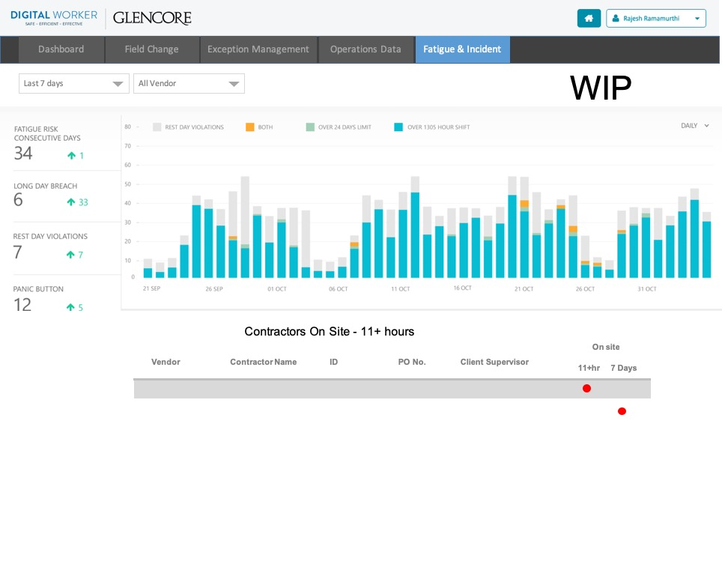


Digital Worker Tracking & Reporting
OVERVIEW
ideyaLabs partnered with our client to provide solution for :
Oil & Gas Industry clients where they have to manage Contractors and resources at Oil rigging locations
ideyaLabs CONTRIBUTION
ideyaLabs architected the application to adopt pure Azure Service Fabric offerings
ideyaLabs implemented API versioning and client specific API maps using API Management services of Azure
All deployments triggered via Visual Studio Team Services build definition
Feature Definition, Information Architecture, UI Design, Data Visualization
Customized Dashboards created using data from OMS and Application Insights
Alerts were defined for watching Service health and maintain SLAs
TECHNOLOGY STACK
NET Core, .NET 4.6.2, SQL Azure, Identity Server, AngularJS 4, NVD3
Azure Resources –Service Fabric, OMS, Application Insights, Blob Storage, Azure SQL, Azure Websites

Slide 54
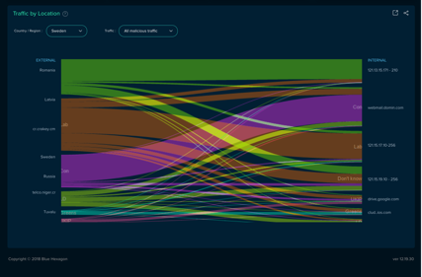
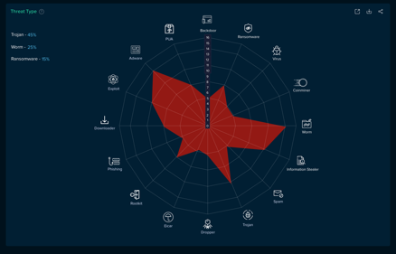
Network Security Application
OVERVIEW
The client is a startup specializing in AI based network security with an innovative product that can detect unknown threats in a matter of seconds as against existing products that take minutes, sometimes hours to do the same
ideyaLabs CONTRIBUTION
Wireframes and UI design were developed, created and fine tuned
An Invision prototype was built and demonstrated to client
React based UI for dashboard being updated in real time
Provision for both shared and dedicated deployments leveraging Terraform and Ansible
Scalable Infrastructure and Storage
SQS and Lambda based server-less implementation for robust and scalable message handling of network threat data
TECHNOLOGY STACK
HTML5, CSS3, D3, ReactJS

Slide 55
Cloud - Practice

Slide 56
Cloud Practice
ideyaLabs cloud offerings span the entire spectrum of services from application to infrastructure and security.
CLOUD SERVICES
APPLICATIONS
DATA & ANALYTICS
INFRASTRUCTURE
SECURITY
DEVOPS
PLAN
BUILD
OPERATE
OPTIMIZE
LAB TESTING AND VALIDATION
KEY TECHNOLOGIES

Slide 57





Cloud Services
APPLICATIONS
DATA & ANALYTICS
INFRASTRUCTURE
SECURITY
DEVOPS
Enterprise Application Migration strategy
Application Migration framework based on public cloud native services
Data Warehouse migration
Hybrid Data Warehouse Implementation
Implementation ETL for processing High volume streaming data
Infrastructure Profiling and Sizing
Infrastructure Performance Benchmarking & Tuning
Usage Monitoring and Optimization
Cloud Data Security
Cloud Infrastructure Security Monitoring
Threat Evaluation Integration
Segmentation and Flow Visibility
Cloud Foundry Implementation
Cloud template - based Orchestration & Resource creation
CI/CD Automation
Blue-Green Deployments

Slide 58













AWS Expertise & Key Services
ASSESSMENT
DEVELOPMENT
MAINTENANCE & SUPPORT
PROFESSIONAL SERVICES
Assess Technology
Assess Operational Readiness
Incorporate Scalability
Map to AWS Constraints
Redundancy Designs
Leverage Parallel Processing.
24*7 Support
Infrastructure Management
Application Modelling.
Automate Operations
Integration with Configuration & Monitoring Tool
Backup, DR/BCP Services
AWS SERVICES
Virtual Private
Cloud
EC2
Route 53
CloudWatch
S3
SNS
RDS
ELB
IAM

Slide 59

Modernization from Legacy Product to Platform
Leading Financial Institution
ideyaLabs SOLUTION
OVERVIEW
Rearchitected the monolithic legacy desktop application into a SOA and Micro-services-based SaaS platform
Developed consistent and responsive UI across various products for Input Form Builder, third party site and core product, leveraging pure CSS
Custom common control library was developed for providing consistent user interface
Converted existing code as Restful APIs to be consumed by applications UI & mobile app
Solved the difficulty of monitoring and managing multiple individual instances for application availability
Developed Micro services for new functionality to be exposed on Amazon leveraging Amazon API Gateway and Lambda functions
Client offers a SaaS based end-to-end solution for mortgage originators
Client wanted to rearchitect the monolithic legacy application which could also be scaled up for a larger user base
To reduce the time of the existing transactions which was taking 12-35 seconds to complete even in a normal load scenario
BUSINESS BENEFITS
30% increase in adoption by the end users
4 times increase in revenue generation per closed loan by full adoption of services
Lowered cost of infrastructure as contracted SaaS buyers were expected to grow double from the existing 200 K users
Enabled lenders, service providers, and ISVs to - easily build their custom loan applications and deploy on cloud
Performance engineering reduced processing time from 9 Sec to 3 Sec.
Automated CI/CD process with more than 90% test cases.
TECHNOLOGY STACK
Microsoft .NET 4.5 and ASP.Net 4.5; Android, Visual Studio 2012, Languages and Tools: ASP.Net MVC 4, C#, AngularJS (MVC), Qunit (unit testing), JS Closures and Namespaces, Media Queries, Selectors and new CSS 3 Constructs

Slide 60


Modernization from Legacy Product to Platform
Architecture
Old Architecture
New Architecture
Secured Login
Login
Application Interface
Security
Web Portal (Loan Application)
Mobile Application
Modules/Services
Business Access Layer
Enterprise Services
Loan Application
Order Credit
Mortgage Insurance Services
AVM Services
Life Insurance Services
Underwriting Services
Services
Client Browser
Web Server (MVC)
Loan Offer Service
Loan Process Service
Order Credit
Process Document
Life/Mortgage Insurance Services
Services
HTML5/CSS3
View
Service Layer
Company Setup / Setting
JavaScript / JQuery / MVVM
Model
Company Setup/Settings
Local Storage
Controller
Data Access Layer
Data Access Layer
Database
Database

Slide 61

Bilateral Netting Solution Migration from Hosted to AWS Cloud
Forex Trades Processing and Settlement Entity
BUSINESS PROBLEM AND SCOPE
To Move from legacy software and hardware infra-structure towards more modern and standardized software and managed services model
To Move from existing active-passive set-up to active-active set-up to cut down cost and disaster recovery time savings
Lower legacy software licensing costs
OVERVIEW
Existing solution is a Blockchain based standardized, automated bilateral payment netting service for FX trades between various trading participant
Solution also involves other third-party applications and Financial Settlement services such as SWIFT
This solution needs to be migrated to AWS based services
ideyaLabs SOLUTION APPROACH
Cloud Migration - Worked on Cloud Migration Strategy such as Lift and Shift or Partial Cloud Native
Cloud Deployment - Worked on multiple Availability Zone based Active-Active set-up for Compute as well as Data Storage planes
Software Modernization – Identified AWS Managed Services for legacy technology components such as older database and messaging systems.
Example use of AWS-RDS with multiple Availability Zone based replicas to migrate from DB2 database
Data Migration – Migrated existing Blockchain and Ledger data to Database instances based on AWS EC2 VMs/instances
BUSINESS BENEFITS
Use of Cloud managed services with less dependence on on-prem and private data centers.
Public cloud benefits for cutting down infra-structure costs and move towards pay-per use model passing the cost savings to the participants.
TECHNOLOGY STACK
AWS Services, IBM MQ, IBM DB2, CouchDB, Java, Docker

Slide 62
Mobile- Practice

Slide 63
Mobility Practice
ideyaLabs provides a holistic approach to first understanding the requirement, evaluating various technologies and then implementing a mobility solution that provides a significant ROI to our customers.
KEY TECHNOLOGIES
APPLICATIONS MANAGEMENT
TESTING
POST DEPLOYMENT
DEVICE MANAGEMENT
SECURITY

Slide 64
Our Mobility Focus
APPLICATIONS MANAGEMENT
TESTING
SECURITY
POST DEPLOYMENT
DEVICE MANAGEMENT
Cross platform application development
Application porting, integration, application testing and publishing to app-store.
Deploying Enterprise App store
ideyaLabs Mobile Test lab
Protocol testing, performance testing, field testing, operator acceptance testing and application testing.
Ready-to-use automation framework
Secured access to Enterprise Assets
Role based device usage permissions and selective access to corporate
User Enrollment and Rights Management
Policy Definition and End-Point Policy Management
Integration with Enterprise systems
Monitoring and tracking use and ensuring policy compliance
Building Analytical Apps and provide actionable insights
Support services like Help-Desk , 24x7 and Self- Service Portals
Planning and Assessment for developing comprehensive strategy
Device Provisioning from Cloud Hosted (Private/ Hybrid) Servers
Dashboard for entire device ecosystem
Profile and Policies configuration to Enable BYOD

Slide 65




iOS and Android Development Services
ideyaLabs delivers scalable and secure iOS & Android applications. We have expertise in enterprise mobility needs like BYOD, Security and MDM
APPS UI/UXA DESIGN
APPS ADEVELOPMENT
APPS TESTING
APPS SUPPORT & MAINTENANCE
End user interaction
Create best suitable user experience
Creating responsive designs & cross-platform layouts based on iOS and Android standards
Create wireframes & multiple theme options for the application
End to End development using Objective C/Swift, Java, or cross platform development tools
Application certification and Cross platform porting across different platforms and Intra-platform porting
Test Strategy Consulting
Manual Testing
Functional Testing
Usability Testing
Network Testing
Accessibility Testing
A/B Testing
Automation Testing
Unit Testing
UI Testing
Specialized Testing like App crashes, Memory Leakage, Security Testing
Post Publishing support
Updates , Bug Fixes & Enhancements
Implementation plan for new releases based on user community feedback

Slide 66
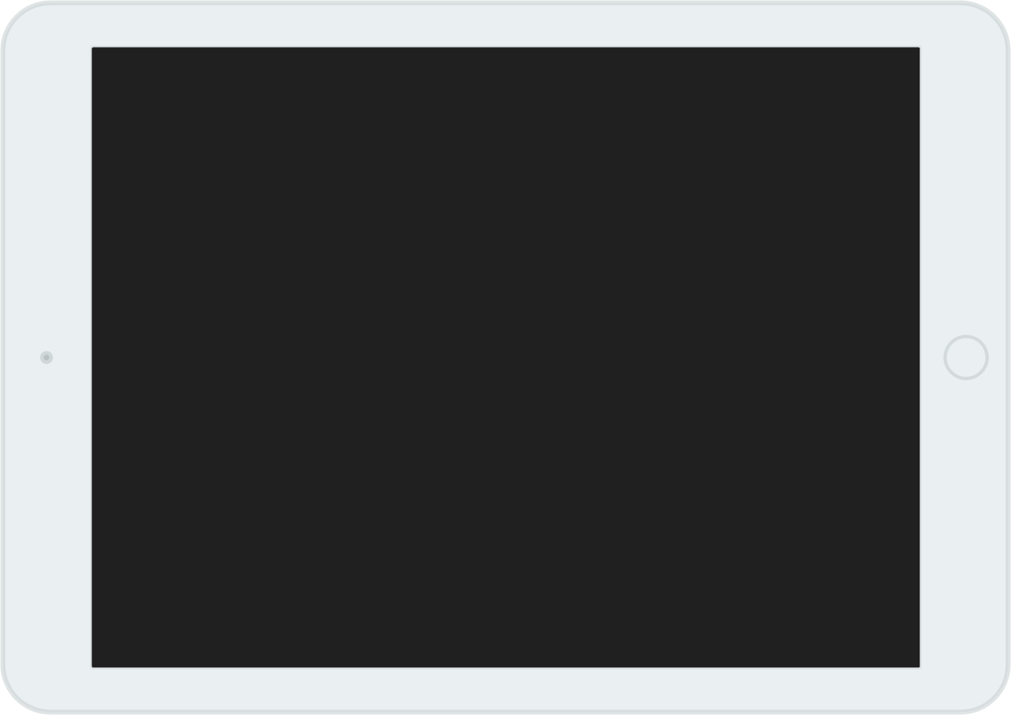

Interactive Android App For Toddlers
Android based application that allows toddlers to experience a new way of playing, watching and interacting directly with Disney Junior TV shows.

Slide 67


OVERVIEW
Android based application that allows toddlers to experience a new way of playing, watching and interacting directly with Disney Junior TV shows
Interactive Android App For Media And Entertainment
SCOPE
Growing the team size which would continue to build and deliver new Appisodes
Build reusable components to reduce development efforts and release products quicker
Build new Appisodes across platforms like iOS, Android, Windows and Firefox
Add to the gaming portfolio of Disney across different mobile platforms
TECHNOLOGY STACK
Android, Cocos2d-x, NDK, C++, Java, Referral Store, comScore, DMOAnalytics, HockeyApp
ideyaLabs SOLUTION
Developed a replica of client’s iOS app on Android which involved interactive videos, voice detection, touch gestures, animations and accelerometer actions
Built a framework comprised of reusable components for voice detection, play-head
and external event handling
Provided support for mobiles / tablets running on Android OS Ice Cream Sandwich (v4.0) onwards
Catered to all types of screen resolutions
Integration of libraries like Referral Store for more Disney Games, MoPub for Ad, DMOAnalytics, Kochava, comScore for Analytics, HockeyApp for tracking crashes

Slide 68
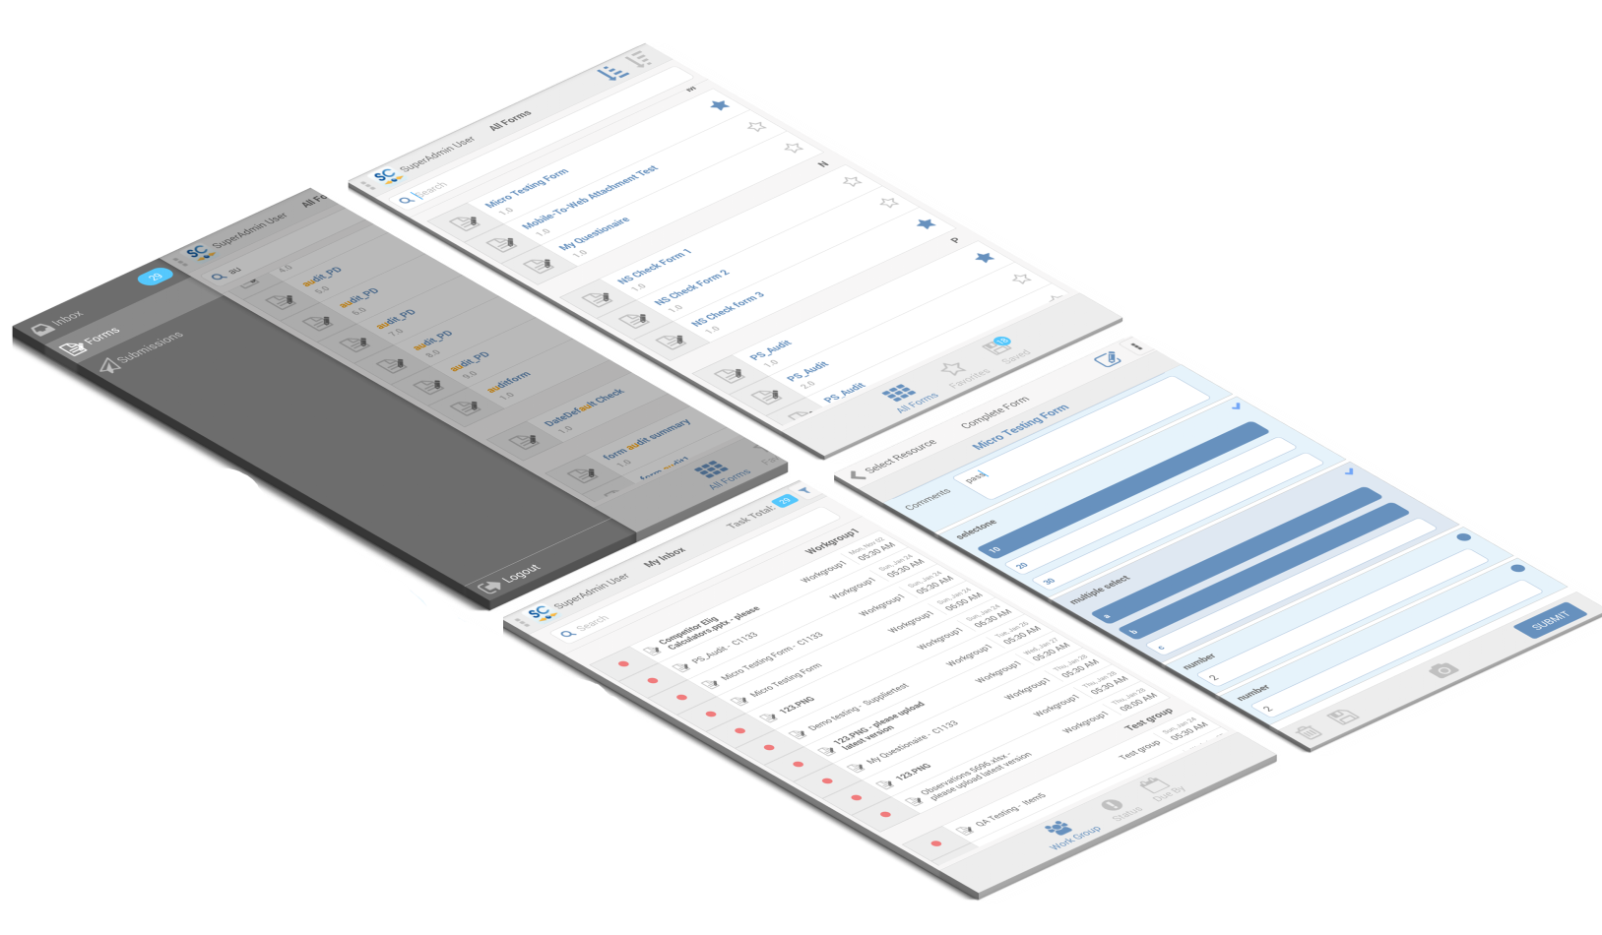
Food Quality Assurance Management Solutions
A web and mobile solution which look after regulatory compliances as well as, safety and quality management of the supply chain of consumable goods manufacturers.

Slide 69
OVERVIEW
Our Client provides cloud-based food safety and quality management solutions to help providers of consumable goods enforce – in real-time.
Web & Mobile Solution For Food Quality Assurance Management
FEATURES
Web based UI Clickable Mode software and a mobile application for Smartphones and Tablet (iOS & Android)
Dashboards for Reports , Alerts, Forms, Audit Trails
Built “Views”
TECHNOLOGY STACK
Web App: Visual Studio 2013, Angular,Kendo UI, LESS, HTML5/CSS3, jQuery, ASP.Net MVC 5, ASP.Net Web API 2.0
Mobile App (iOS and Android): Xamarin Studio – iOS and Android ,XCode, SQLite, SVN ,WCF Rest Service, Android SDK
ideyaLabs SOLUTION
Developed a mobile solution for iOS as well as Android platform with all the web application functionalities
Architected the applications to use a thin mobile Client to be deployed on iOS and Android devices that communicated with a server.
Built “Views” using drag-and-drop functionality and property fields using iOS designer
Developed application using Model-View-View Model with Observer pattern to re-use more components across platforms

Slide 70
QA Capabilities

Slide 71
QA Practice
ideyaLabs brings over two decades of experience helping software teams ensure their products, systems, applications, and platforms behave as per the specifications and remain tightly integrated, secure, and compliant. In this, we have developed extensive testing capabilities for various verticals, across platforms, and applications.
KEY TECHNOLOGIES
HTML
JAVA
MANUAL TESTING
AUTOMATED TESTING
CLOUD TESTING
C++
MOBILE TESTING
PHP
PERFORMANCE ENGINEERING

Slide 72


QA Focus
MANUAL TESTING
AUTOMATED TESTING
MOBILE TESTING
CLOUD TESTING
PERFORMANCE ENGINEERING
Core test services
Functionality and UI
Robustness, Reliability
UI, Accessibility, Usability
Smoke Testing
Regression
Compliance
Expert Test Services
Performance Testing
Security
Globalization, Localization
Compatibility
Interoperability
Logo Compliance and Certification
Proprietary test automation frameworks applicable in multiple domains
Expertise in domain specific methodologies, frameworks & tools, mature processes and metrics driven test management
Agile testing methodology adopted
Proficiency in various commercial and open source functional and Performance testing tools
Enterprise APP
Devices
Browser
Data
Network
Carrier
Functional & Performance
Network, Security, compatibility
Conformance, Usability, Installation/provisioning
Functional Testing
Bandwidth and Latency Testing
Load and Performance Testing
Stress Testing
Testing various cloud solutions such as SaaS, PaaS, IaaS, etc.
Production Performance Projection
Performance/Capacity Modeling
Application Profiling
Predict Application / Infrastructure behavior
Project Performance impact of Infrastructure change
Improve Performance to Cost ratio

Slide 73



Digital Transformation - > Automated testing
Digital Transformation – Automation testing plays an increasingly critical role in the success. Key factors are:
demand for faster releases
higher service levels
backlogs bottlenecks
testing complexity
room for improvement / continuous change requests
feedback loops / Continuous testing
How does Automated testing help
enhanced productivity and time savings
early Issue Identification
quick response to changing business demands
speedy time to market
objectivity & Transparency
higher coverage with greater process consistency & relevant repetition
Reusable
Comprehensive
Fast
Programmable
Cost Reduction
Repeatable
Return on Investment
Reliable
Better Quality
73

Slide 74


























ideyaLabs Test Automation Ecosystem
Programming Language
Test Management Application
Cloud Infra
Technical SME
Business SME
Managers
Functional UI
API
Mobile
QA Engineers
Frameworks
Tools
Developers
Nunit
Xunit
Code UI
Test NG
Automation SME
Xamarin
Junit
Custom
Serverless
Reporting Platforms
Lay Man

Slide 75





ideyaLabs Automation Journey
Device Test
Automation
Automation i360
Mobile Farm
Driving Factor: Application integrated with AWS services. Testing the migration scenarios within stipulated time was difficult. Solution:
Amazon web services, API were tested using support of Boto3 and Tavern libraries.
Driving Factor:
Application supporting varied mobile OS and device types. Procurement for device coverage was costly. Solution:
Usage of cloud-based devices for automated testing.
Internal Secured Private Cloud.
Driving Factor:
App integration with other hardware devices with Bluetooth technology. Test Automation on Physical device is complex. Solution:
Bluetooth Simulated Automation
Print & Scan Automation
Mobile
Automation
iTAF
Driving Factor:
Large set of regression test suite exécution causing delay in time to production.
Solution:
Moduler Framework
3 tier architecture Web applications.
Driving Factor: Native Mobile And Web App integration Solution:
Extended iTAF for Native Mobile App.
2015
2016
2017
2018
2020

Slide 76









Rapid Automation Cycle
Leveraging our approach of Rapid Automation, reduction in testing efforts can be achieved
Work with QA Manager & SME
Identify and brainstorm on test cases prioritization
Work closely with Offshore resource
Provide Training
Onsite Lead
Client QA Manager
ideyaLabs Project Manager
PROJECT PLANNING & PRIORITIZATION
Specialists analyze and review test cases
Identify issues in manual test cases
Remove any gaps for automation
Plan test cases with steps
Prepare test data
ideyaLabs Test Specialist
Advantages
Agile & Extensible
Qualitative Advantage
Reduced Cycle Time & Manual Efforts
Quick and Easy onboarding
Rapid Process Orientation
Better Process Overview for stake holders
Continuous Governance
Test Specialist
TEST PREPARATION & PRE-AUTOMATION
ideyaLabs Automation Engineers
Develop automation scripts
Execute and Test
Build and Deploy
Prepare documentation
SCRIPT DEVELOPMENT
Automation Engineers
Increased Efficiency & Quality

Slide 77




Business Benefits
BENEFITS
TIME
70% reduction in testing efforts for Regression Test Cases
Reduced 40% bug leakage in cross browser testing and testing with different browser settings
65% reduction in overall effort spent for Product Testing
COST
Provided 93% of total regression test coverage by creating robust reusable functions and test scripts
Calculated track for ROI throughout the SDLC
QUALITY

Slide 78


Automation-i360 in Cloud Applications
Financial services and software company
BUSINESS PROBLEM AND SCOPE
Client faced the following challenges and was expecting vendor to perform automation testing:
Distributed set of services used across cloud which included AWS Services, API, UI
High rate of Production Defect Leakage and a long list of Items on Road map necessitated robust automation of basic functionality
OVERVIEW
Most of client infrastructure is hosted on AWS. Multiple services are intertwined to achieve existing workflow. These include Glue, Athena, Spark, Lambdas etc. To ensure that E2E cloud-based workflows are working as expected this automation framework was developed
ideyaLabs SOLUTION
Developed an open source technology based Robust POM (Page Object Model) Cloud Framework that encompasses Cloud Services, UI and API Testing
Framework was developed using Python, Pytest, Selenium, Tavern, Boto3.
Artillery was also used as a separate module for performance testing
Used lightweight and easy to develop YAML Files for API testing thereby simplifying script development for API Automation
Prioritizing AWS Services automation followed by API Test Automation then UI Automation. This ensures crucial functionality which was at cloud level was secured first; followed by API Verification of data flows
BUSINESS BENEFITS
AWS Library can be used with any AWS Automation Project. Plug and Play technique.
Tavern Test API Framework Used which is compatible with Pytest
Immediate detection of any showstopper issues.
Integration with Test Rail assures standard reporting across all stakeholders
TECHNOLOGY STACK
Python, Pytest, Selenium, Boto3, Tavern, Artillery

Slide 79


Testing Services for Personal Finance Application
BUSINESS PROBLEM AND SCOPE
Personal Finance Company
ideyaLabs developed a growth, training and execution plan to meet client’s requirements
The team comprises of Test management which includes test designers and manual testers
OVERVIEW
Client’s mobile application gives users access to all of their financial information —bank accounts, credit cards, bills, mortgages, loans, and, of course, your credit scores — all in one location, all under one account.
ideyaLabs SOLUTION
ideyaLabs conducted a complete QA cycle in the respective phases for testing the native application across devices and networks
Testing services: Manual Testing, Security Testing, Exploratory Testing, Black Box Testing and Database Testing
Created complete test plan for both generic and platform test cases
Used Appium for verification of Native app’s functionality and UI testing
Appium tool was used for testing across multiple mobile operating systems of iOS and android , with the same automated script
Due to the presence of Selenium web drive, Appium tool was also used to render support for multiple languages for development (Java, C#)
BUSINESS BENEFITS
Reduced business cycle time, achieved more accuracy and overall operational efficiency
Overnight running test cycle by offshore team saves time
Zero defect leakage
Complied with several federal laws and standards like OWASP
Top 5 rated apps with 5 start reviews
TECHNOLOGY STACK
JIRA, TestRail, Confluence, SQL, Android SDK, Selenium, Appium

Slide 80

QA of Mortgage Products
Leading Mortgage Software Provider
ideyaLabs SOLUTION
Functional Tests-
ideyaLabs extensively worked in areas like - Loan Origination, Product & Pricing Services, Consumer Portal, Third Party Origination, Secondary Market, Total Quality, Mortgage CRM, EDS,ECS.
About 15+ functional SME are trained on Mortgage domain and Expertise in doing the end to end functional tests of the Loan origination product. Complete Calcs and compliance related changes are handled by functional SMEs. Web Encompass is being currently tested by the team.
Performance Tests-
ideyaLabs has dedicated resources for the performance tuning and execution of the performance scripts. Team has expertise in Load Runner, Web load, SOAP UI and Jmeter.
Team has engaged to do performance test for multiple platforms and has developed the critical production work flow patterns and executes them on daily basis.
API Tests-
Team has engaged in testing APIs for platform for mortgage application. Manual and automation testing is performed using SOAPUI and automation framework.
Automation Tests-
ideyaLabs team developed automation scripts for UI, mobile, API and has developed 2500+ test scripts with 90% coverage on the automation.
OVERVIEW
Our client is a US based Leading provider of innovative on-demand software solutions (SaaS) and services for the residential mortgage industry
It offers a cloud-based all-in-one mortgage management solution that allows banks, credit unions and mortgage lenders to originate and fund mortgages and improve compliance, loan quality and efficiency
BUSINESS BENEFITS
Achieved minimum regression timeframe speeding up the release cycle to production, regression cycle optimized from 4 weeks to 1 week cycle
API Automation – Team has successfully used SOAP UI and SOAP UI Pro version to automate 100% API (SOAP + REST) related test cases
Achieving 100% Automation of the functionalities developed within the same sprint
TECHNOLOGY STACK
Selenium WebDriver, HP UFT, Core JAVA, SOAP UI, JIRA, TFS, Eclipse, Jenkins, Groovy Scripting, Load Runner, Web Load and JMeter

Slide 81

Automation Testing of Mobile Application
Provider of networked crisis communication solutions
BUSINESS PROBLEM AND SCOPE
Large set of Regression Test Cases that needs to be executed on multiple devices and multiple OS versions in limited time frame
QA Taking longer time than Development due to vast scope of Test Cases and Devices
Production Defect Leakage
OVERVIEW
Our Client has comprehensive suite for crisis communications within and between organizations, people, devices, and external entities as to enable informed decisions and effectively protect the people and communities in general
ideyaLabs SOLUTION
Developed an open-source technology based Robust POM (Page Object Model) based Mobile Automation Framework that caters to both Android (version 4.4.4 & onwards in HTC, Motorola, Samsung S4 onwards) and iOS (version 9.0.1 & onwards in iPhone 6 onwards) Devices
Framework was developed using Robot Framework, Appium for mobile related interaction & Selenium for Web Interaction
Single Script for Android and iOS Test Cases handled at Keyword Level
Added 3rd Party apps (ES File Explorer/Location Demo/Fake GPS) for covering edge cases
Integrated Database for DB Level validations of various Mobile App features
Media (Image/Video Uploads) related operations were also incorporated in Automation Scripts and DB Validation
Map related Test Cases were automated using Firefox and DB Validation
BUSINESS BENEFITS
Overnight execution achieved to ensure maximum Test Coverage benefits
Any defect or any anomaly reporting done on devices that may not be used by Manual QA Team.
Immediate detection of any showstopper issues & device related anomalies
Integration with ALM assured standard reporting across all stakeholders
TECHNOLOGY STACK
JSON Wire Protocol, Selenium, Device (Android/IOS), Appium, ES File Explorer, Android SDK, iOS X- Code, Robot Framework, Python

Slide 82







ideyaLabs Test Automation Framework: iL-TAF
KEY FEATURES
Built using industry standard architecture and technology
Platform and application independent
Aggregation of frontend, backend, and database test cases in a single script
Flexibility to replicate from technologies like Ruby, Python including Open Source
Compatible with multiple browsers
Generates master/detailed reports
Page Object
Test Suite
Reporting Layer
Test Script
Test Report Module - 1
Test Suite Report - 1
Web
Object Repository
Module - 1
SSH
Database
Test Script
Test Suite Report - 2
Page Objects
Test Report Module - 2
Module - 2
iL-TAF KEY BENEFITS
Reduced QA cycle time by about 50% for both web and enterprise applications
Increased test speed and software quality
Improved ROI as Open-source tools are deployed
Minimal to no maintenance
Decreased costs and shorter Time to Market
XML
REST API
Test Script
Test Suite Report - 3
Test
Data
Test Report Module - 3
IOS
Module - 3
Android

Slide 83
Mobile Application Testing
Device & OS
Browser
Data
Carrier
Network
Device Level Testing
Device Types for Multiple OS Platforms and Fragmentation
Battery utilization
Screen Size, Form Factors, Appearance, Screen Resolutions & available hardware configurations Testing
Conformity to common key functions
Memory Consumption and Performance with different memory size(RAM)
Browser & Data Testing
Cross browser Testing
Metrics measurement like headers, request/response, performance numbers, etc.
Data usage and Performance Testing
Sensitive data storage and validation
Interoperability Testing
Usability Testing
Orientation Testing
Application upgrade and Localization Testing
Network & Carrier Testing
Mobile application compatibility with different networks (CDMA 2000, GSM, W-CDMA, GPRS, etc) and across various carriers.
GSM/UMTS/HSPA Protocol Testing
2G, 3G and 4G device carrier Validation Testing
Network Conditions
Security
Phone Simulator
Device Anywhere
User Agent Strings
HttpWatch - plug-ins for IE and Firefox
DeviceAnywhere
FoneMonkey
Well established, Ready-to-use frameworks for mobile automation testing (Native/Hybrid/Web App)
83

Slide 84
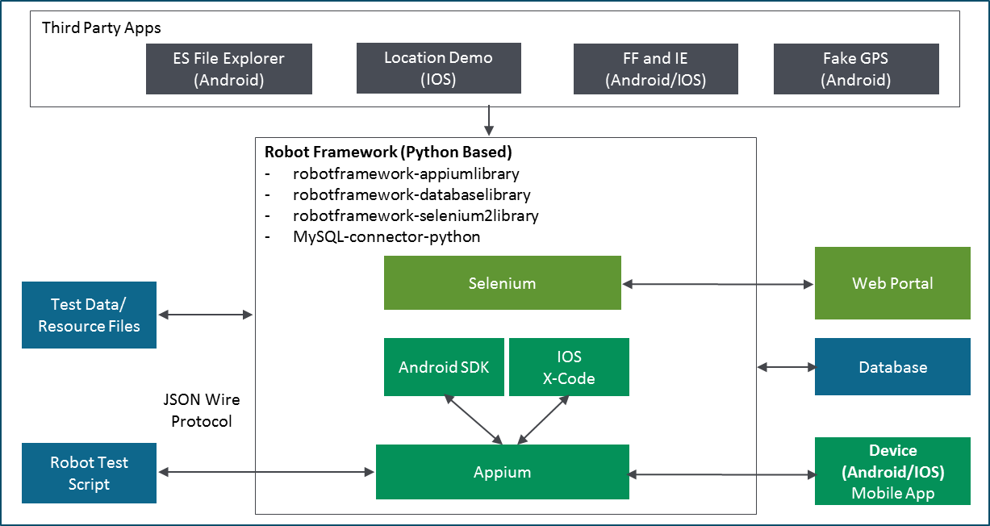




Mobile Automation Testing
ideyaLabs has developed ready-to-use automation framework with a keyword driven approach to support different operating systems and their various respective versions
Platform independent and generates automation scripts for different types of apps
Enables continuous integration and minimizes manual testing efforts
Robust POM (Page Object Model) based Mobile Automation Framework that caters to both Android and IOS Device
Framework developed using Robot, Appium for mobile interaction & Selenium for web interaction
Framework can be customized to suit device specific functions which are done differently per device (E.g. app going to background)
Mobile Automation Framework Design
Calaba.sh
84

Slide 85
Testing Services for Personal Finance Application
BUSINESS PROBLEM AND SCOPE
Personal Finance Company
ideyaLabs developed a growth, training and execution plan to meet client’s requirements
The team comprises of Test management which includes test designers and manual testers and Automation experts
OVERVIEW
Client’s mobile application gives users access to all of their financial information —bank accounts, credit cards, bills, mortgages, loans, and, of course, your credit scores — all in one location, all under one account.
ideyaLabs SOLUTION
ideyaLabs conducted a complete QA cycle in the respective phases for testing the native application across devices and networks
Testing services: Manual Testing, Security Testing, Exploratory Testing, Black Box Testing, Database Testing and Automation
Created complete test plan for both generic and platform test cases
Used Appium for verification of Native apps functionality and UI testing
Appium tool was used for testing across multiple mobile operating systems of iOS and Android with the same automated script
Due to the presence of Selenium webdrive, Appium tool was also used to render support for multiple languages for development (Java, C#)
BUSINESS BENEFITS
Reduced business cycle time, achieved more accuracy and overall operational efficiency
Overnight running test cycle by offshore team saves time
Zero defect leakage
Complied with several federal laws and standards like OWASP
Top 5 rated apps with 5 start reviews
TECHNOLOGY STACK
Jira, TestRail, Confluence, SQL, Android SDK, Selenium, Appium
85

Slide 86
QA for On Demand File Storage Provider
On Demand File Storage Provider
ideyaLabs SOLUTION
ideyaLabs conducted a complete QA cycle in the phases for testing the native application across devices and networks
Created complete test plan for both generic and platform test cases
Used Calabash for verification of native apps functionality and UI testing
Due to the presence of attributes from Ruby and Cucumber, the Calabash tool was used for supporting behavioral testing activities
Used Calabash tool to generate detailed HTML and XML format reports
Configured Calabash with the continuous integration system to eliminate additional debugging steps.
BUSINESS PROBLEM AND SCOPE
Our client application- Native file sharing application for storing, accessing and sharing files of any size and format with colleagues and business partners
The application developed for Android and iOS platforms
TECHNOLOGY STACK
BUSINESS BENEFITS
Jira, TestRail, Confluence, SQL, Android SDK, Selenium, Appium
Reduced business cycle time, achieved more accuracy and overall operational efficiency
Overnight running test cycle by offshore team saves time
Zero defect leakage
Complied with several federal laws and standards like OWASP
Top 5 rated apps with 5 start reviews

Slide 87

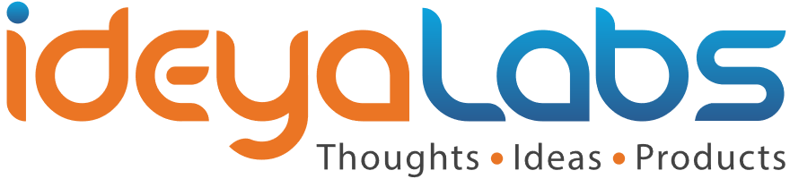
Thank You
© ideyaLabs| www.Ideyalabs.com | Confidential
Contact:
PrasadS@ideyalabs.com

